Slide 1

Process Deadlocks

Slide 2
Process Deadlocks (6 hrs.)
+Introduction
+Deadlock is a situation where a set of processes are blocked because each process is holding a resource and waiting for another resource acquired by some other process.
+A Deadlock is a situation where each of the computer process waits for a resource which is being assigned to some another process. In this situation, none of the process gets executed since the resource it needs, is held by some other process which is also waiting for some other resource to be released.

Slide 3
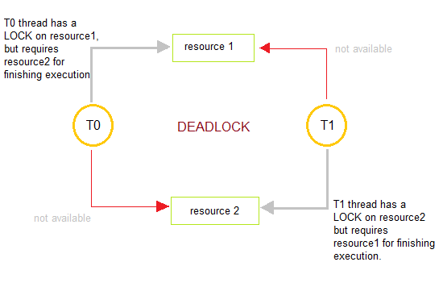
DeadLock
+In this figure, process T0 has resource1, it requires resource2 in order to finish its execution. Similarly, process T1 has resource2 and it also needs to acquire resource1 to finish its execution. In this way, T0 and T1 are in a deadlock because each of them needs the resource of others to complete their execution but neither of them is willing to give up their resources.

Slide 4

Deadlock
In General, a process must request a resource before using it and it must release the resource after using it. And any process can request as many resources as it requires in order to complete its designated task.
And there is a condition that the number of resources requested may not exceed the total number of resources available in the system.

Slide 5
Deadlock
+Basically in the Normal mode of Operation utilization of resources by a process is in the following sequence:
+Request: Firstly, the process requests the resource. In a case, if the request cannot be granted immediately(e.g: resource is being used by any other process), then the requesting process must wait until it can acquire the resource.
+Use: The Process can operate on the resource ( e.g: if the resource is a printer then in that case process can print on the printer).
+Release: The Process releases the resource.

Slide 6
Types of Resources
+ a resource is an object that a process makes use of. A resource can be a piece of hardware such as : tape drive , disk drive ,printer etc.
+or a piece of information such as : a file , a record within a file ,a shared variable ,a critical section etc.
+A computer typically has many different resources. In some cases there may be many instances of a resource of a given type (e.g. buffers), all of which are equivalent. A process needing one of these resources can use any one of them. In other cases there may be only one instance of a resource (e.g. CD-ROM drive with a particular CD).

Slide 7
Types of Resources
+Resources come in two Flavors:
preemptable.
preemptable and Non
+A preemptable resource is one which can be allocated to a given process for a period of time, then be allocated to another process and then be reallocated to the first process without any ill effects. Examples of preemptable resources include memory , buffers
, CPU ,etc.
+A Non preemptable resource cannot be taken from one process and given to another without side effects. One obvious example is a printer: certainly we would not want to take the printer away from one process and give it to another in the middle of a print job

Slide 9
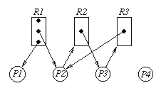
Resource Allocation Graph
+We can use a directed
a resource-allocation
graph
graph
called
to
characterize a deadlock situation.
+Vertices represent resources and processes. We will use rectangular vertices to represent resource classes, with dots within the vertex to represent
instances
vertices
of the resource. Circular
will be used for processes.

Slide 10

Resource Allocation Graph
+A directed edge from a process vertex to a resource vertex indicates that the process has requested an instance
of the resource. This is called
a request edge.
+A directed edge from a dot within a
resource vertex
the resource) to
(an instance of
a process vertex
indicates that the resource has been allocated to the process. This is called a assignment edge.

Slide 11
Resource Allocation Graph
+ in this example the class represented by R1 has three instances of the resource associated with it. P1 and P2 each have allocated an instance of a resource of type R1. P2 has requested an instance of resource type R2, but is waiting since the only instance is held by P3. P3 is in turn requesting a resource of type R3 but the only instance of that type is held by P2. The situation depicted in this graph is deadlocked. P2 is waiting for a resource held by P3, and P3 is waiting for a resource held by P2. This can be shown to be a cycle with
+ P2 -> R2 -> P3 -> R3 -> P2

Slide 12
Conditions for Deadlock
+ The deadlock situation can only arise if all the following four conditions hold simultaneously:
+ 1.Mutual Exclusion
+ According to this condition, at least one resource should be non-shareable (non-shareable resources are those that can be used by one process at a time.)
+ 2. Hold and wait
+ According to this condition, A process is holding at least one resource and is waiting for additional resources.
+ 3. NO pre-emption
+ Resources cannot be taken from the process because resources can be released only voluntarily by the process holding them.
+ 4. Circular wait
+ In this condition, the set of processes are waiting for each other in the circular form.
+ The above four conditions are not completely independent as the circular wait condition implies the hold and wait condition. We emphasize on the fact that all four conditions must hold for a deadlock.

Slide 13
Deadlock Prevention
Deadlock Ignorance
Handling Deadlock
Deadlock Avoidance
Bankers Algorithm
Deadlock Detection
Resource Allocation
Recovery from Deadlock

Slide 14

Deadlock Ignorance
+Pretend that there is no problem, it is the easiest way to deal with the problem.
+The simplest approach is the ostrich algorithm: stick your head in the sand and pretend there is no problem at all.
+Different people react to this strategy in different ways. Mathematicians find it totally unacceptable and say that deadlocks must be prevented at all costs.

Slide 15
Ostrich Algorithm
+This Method is reasonable if :
+Deadlock occur very rarely
+Cost of Prevention is high
+UNIX and Windows take this approach
,just ignore the
problem on the assumption that most users would prefer an occasional deadlock to a rule restricting all users to one process, one open file, and one of everything.
+Deadlocks typically handled by rebooting.

Slide 16
Handling Deadlock
+Deadlock Prevention
+Deadlock happens only when Mutual Exclusion, hold and wait, No pre-emption and circular wait holds simultaneously. If it is possible to violate one of the four conditions at any time then the deadlock can never occur in the system.
+The idea behind the approach is very simple that we have to fail one of the four conditions but there can be a big argument on its physical implementation in the system.

Slide 17

Deadlock prevention
+Denying the mutual exclusion:
+Theoretically,
by denying
deadlock can be
the mutual
prevented
exclusion
precondition. This is usually not possible in
practice, convert
though the use of spooling to serially reusable devices into
seemingly shareable virtual devices could be regarded as an attack at this point. (We could also regard it as a multiplication of the number of printers to the point where each process can have all it needs.)

Slide 18
Deadlock prevention
+Denying the hold and wait precondition
+Deadlock can be prevented by denying the hold and wait
precondition. One approach is as follows:
+1. Require that a process request all the resources that it needs in one single request at process start-up. The system will not grant any resource in the list until it can grant all of them.
+2. A less restrictive approach is to allow a process to request resources only when it is currently holding no resources. Thus, if a process needs a new resource, it must first yield all the resources it has and then put in its request (which might include a request for the reallocation of a resource it just gave up.)

Slide 19
Deadlock Prevention
+Problems with this approach:
+It can lead to processes holding resources when they don't need them, thus reducing resource utilization. This is especially serious if a process does not know what resources it will actually need for a given run until it has started working on the data. With this scheme, it must request up front all the resources it might need.
+A process that needs several popular resources might starve while processes that need a smaller number of these resources keep taking them away.

Slide 20
Deadlock Prevention
+ Denying the no pre-emption precondition
+ Deadlock can be prevented by denying the no pre-emption precondition.
+ Deadlock arises due to the fact that a process can't be stopped once it starts.
However, if we take the resource away from the process which is causing deadlock then we can prevent deadlock.
+ This is not a good approach at all since if we take a resource away which is being used by the process then all the work which it has done till now can become inconsistent.
+ Example: A process holds a tape drive and requests a line printer. If a line printer is not available, the tape drive is taken away and the process is put into a state of waiting for both a tape drive and a line printer.

Slide 21
Deadlock Prevention
+This scheme also has problems:
+It only works if the resources are preemptible. If a process has printed output on a line printer and is waiting for some other resource before it can generate more output, then the line printer really cannot be taken away without messing up the output. (This assumes the approach used by the the system is not practical, as it often is not.)
+This scheme can also lead to starvation for a process that needs several popular resources at the same time, since it may keep losing the resources it gets because they don't all become available at the same time.

Slide 22
Deadlock Prevention
+Making circular wait impossible
+The Fourth necessary condition to cause deadlock is circular wait, In order to ensure violate this condition we can do the following:
+Assign a priority number to each resource. There will be a condition that any process cannot request for a lesser priority resource. This method ensures that not a single process can request a resource that is being utilized by any other process and due to which no cycle will be formed.
+Example: Assume that R5 resource is allocated to P1, if next time P1 asks for R4, R3 that are lesser than R5; then such request will not be granted. Only the request for resources that are more than R5 will be granted.

Slide 23
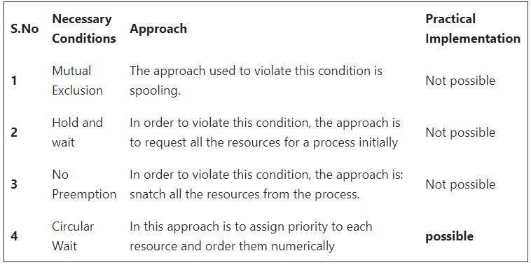
Deadlock Prevention

Slide 24
Deadlock Avoidance in Operating System
+In this method, the request for any resource will be granted only if the resulting state of the system doesn't cause any deadlock in the system. This method checks every step performed by the operating system. Any process continues its execution until the system is in a safe state. Once the system enters into an unsafe state, the operating system has to take a step back.
+According to the simplest and useful approach, any process should declare the maximum number of resources of each type it will need. The algorithms of deadlock avoidance mainly examine the resource allocations so that there can never be an occurrence of circular wait conditions.
+Deadlock avoidance can mainly be done with the help of Banker's Algorithm.

Slide 25
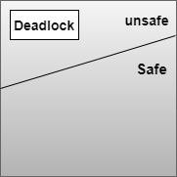
Safe State and Unsafe State
+ Let us first understand the concept of Safe and Unsafe states
+ A state is safe if the system can allocate resources to each process( up to its maximum requirement) in some order and still avoid a deadlock. Formally, a system is in a safe state only, if there exists a safe sequence.
+ So a safe state is not a deadlocked state and conversely a deadlocked state is an unsafe state.
+ Unsafe state cannot allocate resources to the
process.

Slide 26
Bankers Algorithm
+Banker's algorithm is a deadlock avoidance algorithm. It is named so because this algorithm is used in banking systems to determine whether a loan can be granted or not.
+Consider there are n account holders in a bank and the sum of the money in all of their accounts is S. Every time a loan has to be granted by the bank, it subtracts the loan amount from the total money the bank has. Then it checks if that difference is greater than S. It is done because, only then, the bank would have enough money even if all the n account holders draw all their money at once.
+Banker's algorithm works in a similar way in computers.

Slide 27
Characteristics of Banker's Algorithm
+If any process requests for a resource, then it has to wait.
+This algorithm consists of advanced features for maximum resource allocation.
+There are limited resources in the system we have.
+In this algorithm, if any process gets all the needed resources, then it is that it should return the resources in a restricted period.
+Various resources are maintained in this algorithm that can fulfill the needs of at least one client.

Slide 28
Data Structures used to implement the
Banker’s Algorithm
+Let us assume that there are n processes and m resource types.
+Available :It is an array of length m. It represents the number of available resources of each type. If Available[j] = k, then there are k instances available, of resource type Rj.
+Max:It is an n x m matrix which represents the maximum number of instances of each resource that a process can request.
+Allocation: It is an n x m matrix which represents the number of resources of each type currently allocated to each process.
+Need:It is a two-dimensional array. It is an n x m matrix which indicates the remaining resource needs of each process.

Slide 29

+Bankers Resource Request
+Bankers Safety Algorithm
Bankers Algorithm

Slide 30

Disadvantages of Banker's Algorithm
+ Some disadvantages of this algorithm are as follows:
+ During the time of Processing, this algorithm does not permit a process to change its maximum need.
+ Another disadvantage of this algorithm is that all the processes must know in advance about the maximum resource needs.
+ This algorithm permits the requests to be provided in constrained time, but for one year which is a fixed period.

Slide 31
Deadlock Detection and Recovery
+ Deadlock Detection is an important task of OS. As the OS doesn’t take many precautionary means to avoid it. The OS periodically checks if there is any existing deadlock in the system and take measures to remove the deadlocks.
+An algorithm is used to examines the state of the system in order to determine whether a deadlock has occurred.
+An algorithm that is used to recover from the deadlock.

Slide 32
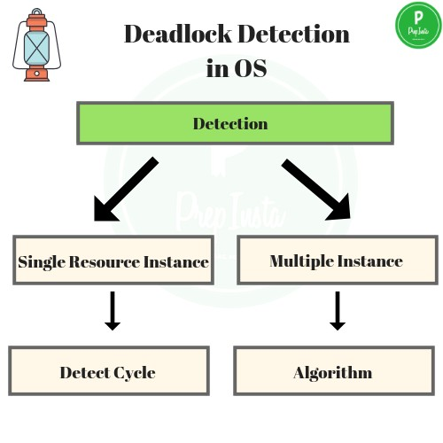
Deadlock Detection and Recovery
+Detection
+If resource has single Instance
+We make a Wait- For graph.
+If resources have multiple
instances
+We make a different algorithm.

Slide 33

Deadlock Detection
+Single instance deadlock detection:
+If all resources have only a single instance, then we can define a deadlock detection algorithm that uses a variant of the resource
–allocation graph, called wait-for graph.
+We obtain this graph from the resource- allocation graph by removing the resource nodes and collapsing the appropriate edges.
+An edge from p_{i} to p_{j} in a wait-for graph implies that process p_{i} is waiting for process p_{j} to release a resource that p_{i} needs.

Slide 34
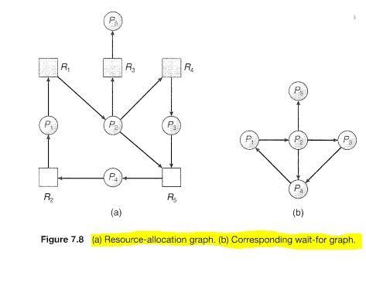
Deadlock Detection
+ An edge p_{i} -> p_{j} exist in wait –for graph if and only if the corresponding resource –allocation graph contains two edges P_{i}-> R_{ij} and R_{q}-> p_{i} for some resource
+ The first figure contains Resource allocation graph and second figure contains Wait-for graph.
+ A deadlock exists in the system if and only of the wait- for graphcontains a cycle.
+ To detect deadlock , the system needs to maintain the wait-for graph and periodically invoke an algorithm that searches for a cycle in the graph.
+ An algorithm to detect a cycle in a graph requires an order of n² operations, where n is the number of vertices in the graph.

Slide 35
Deadlock Detection
+ If there are multiple instances of resources
+ By multiple instance we mean one resource may allow 2 or more accesses concurrently, in such cases –
+ Wait for graph is not applicable.
+ In this, a new algorithm is used. It’s a bit similar to Banker’s Algorithm, but Bankers Algorithm is different.
+ It too uses 3 data structures –
+ Available: Vector of length m , Indicates number of available resources of each type.
+ Allocation :Matrix of size n*m , A[i,j] indicates the number of j th resource type allocated to i th process.
+ Request :Matrix of size n*m , Indicates request of each process.
+ Request[i,j] tells number of instance Pi process is request of jth resource type.

Slide 36
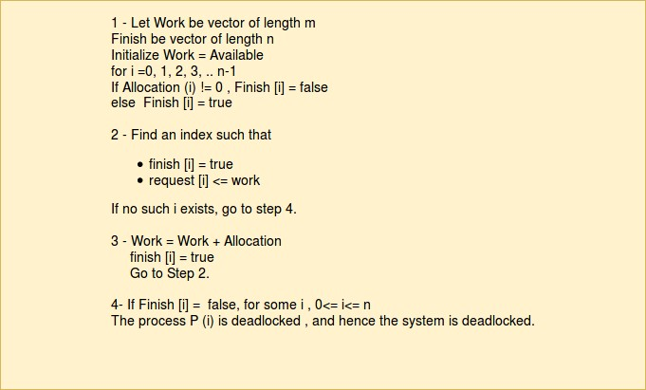
Deadlock Detection

Slide 37
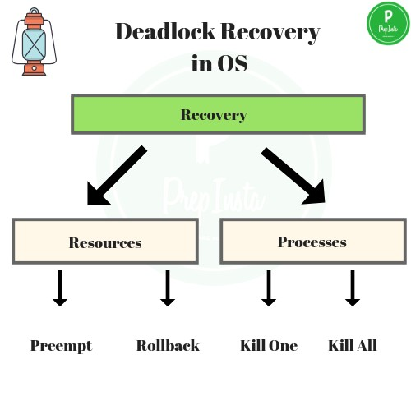
Deadlock Recovery

Slide 38
Kill the Process – One way is to kill all the process in deadlock or the second way kill the process one by one, and check after each if still deadlock exists and do the same till the deadlock is removed.
Pre-emption – The resources that are allocated to the processes involved in deadlock are taken away(pre-empted) and are transferred to other processes. In this way, system may recover from deadlock as we may change system state.
Deadlock Recovery
Rollback – The OS maintains a database of all different states of system, a state when the system is not in deadlock is called safe state. A rollback to previous ‘n’ number of safe states in iterations can help in the recover.

Slide 39
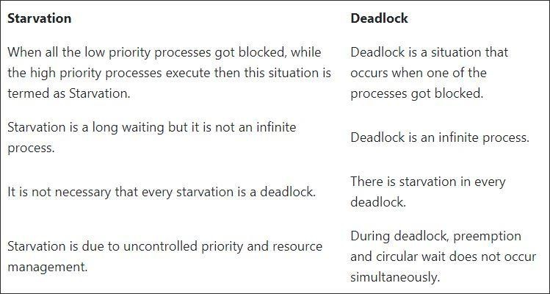
Last but not the least

Slide 40
Thank You

Slide 41
Disk Scheduling
The operating system is responsible for using hardware efficiently — for the disk drives, this means having a fast access time and disk bandwidth
Access time has two major components
Seek time is the time for the disk are to move the heads to the cylinder containing the desired sector
Rotational latency is the additional time waiting for the disk to rotate the desired sector to the disk head
Minimize seek time
Seek time ≈ seek distance
Disk bandwidth is the total number of bytes transferred, divided by the total time between the first request for service and the completion of the last transfer

Slide 42
Disk Scheduling (Cont)
Several algorithms exist to schedule the servicing of disk I/O requests
We illustrate them with a request queue (0-199)
98, 183, 37, 122, 14, 124, 65, 67
Head pointer 53
42

Slide 43
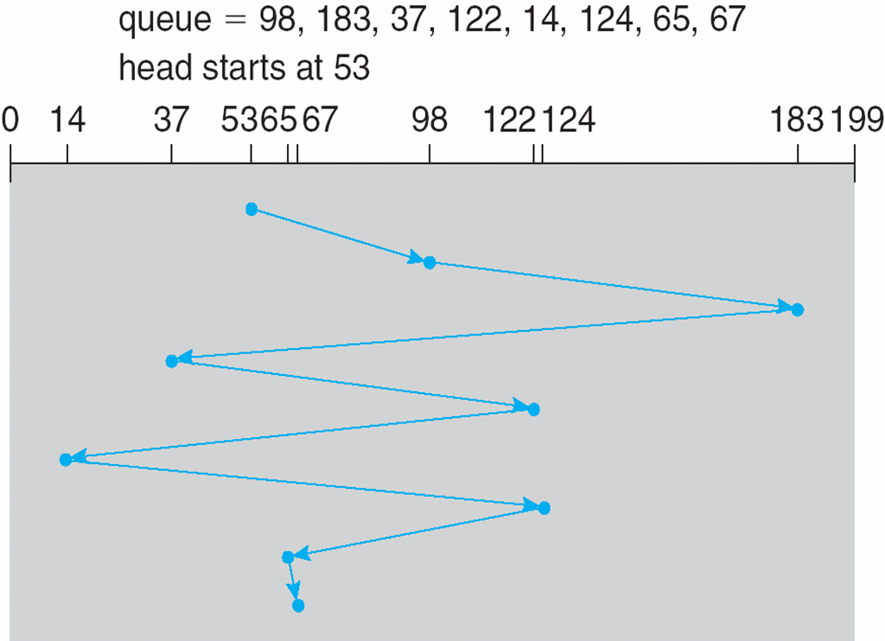
FCFS
Illustration shows total head movement of 640 cylinders
43

Slide 44
SSTF(Shortest Seek Time First)
Selects the request with the minimum seek time from the current head position
SSTF scheduling is a form of SJF scheduling; may cause starvation of some requests
Illustration shows total head movement of 236 cylinders
44

Slide 45
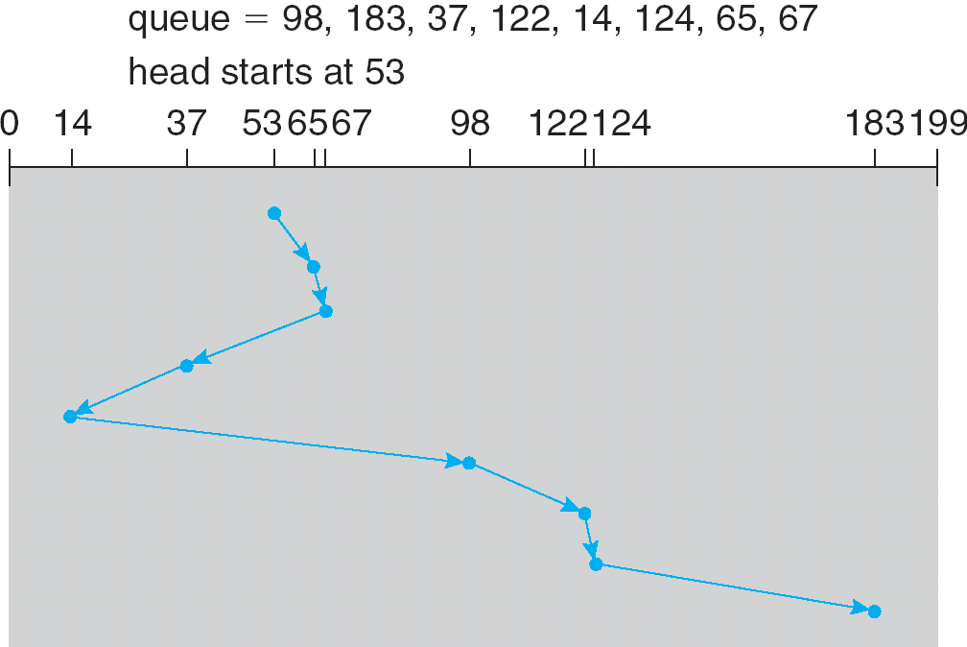
SSTF (Cont)
45

Slide 46
SCAN
The disk arm starts at one end of the disk, and moves toward the other end, servicing requests until it gets to the other end of the disk, where the head movement is reversed and servicing continues.
SCAN algorithm Sometimes called the elevator algorithm
Illustration shows total head movement of 208 cylinders
46

Slide 47
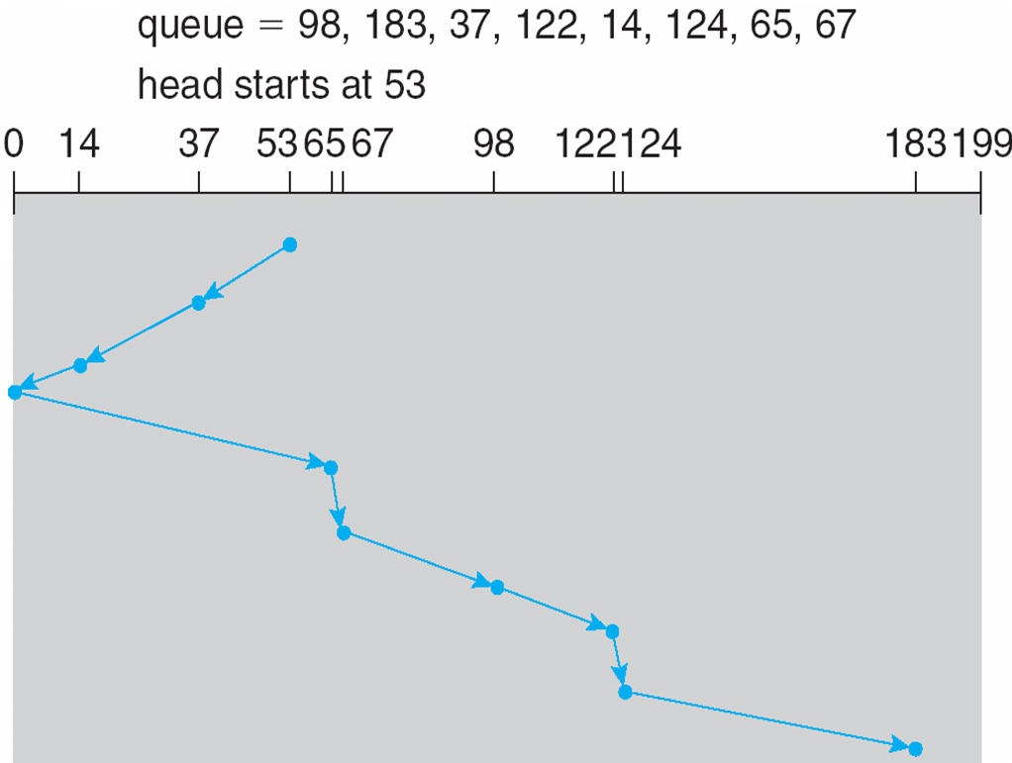
SCAN (Cont.)
47

Slide 48
C-SCAN(Circular)
Provides a more uniform wait time than SCAN
The head moves from one end of the disk to the other, servicing requests as it goes
When it reaches the other end, however, it immediately returns to the beginning of the disk, without servicing any requests on the return trip
Treats the cylinders as a circular list that wraps around from the last cylinder to the first one
48

Slide 49
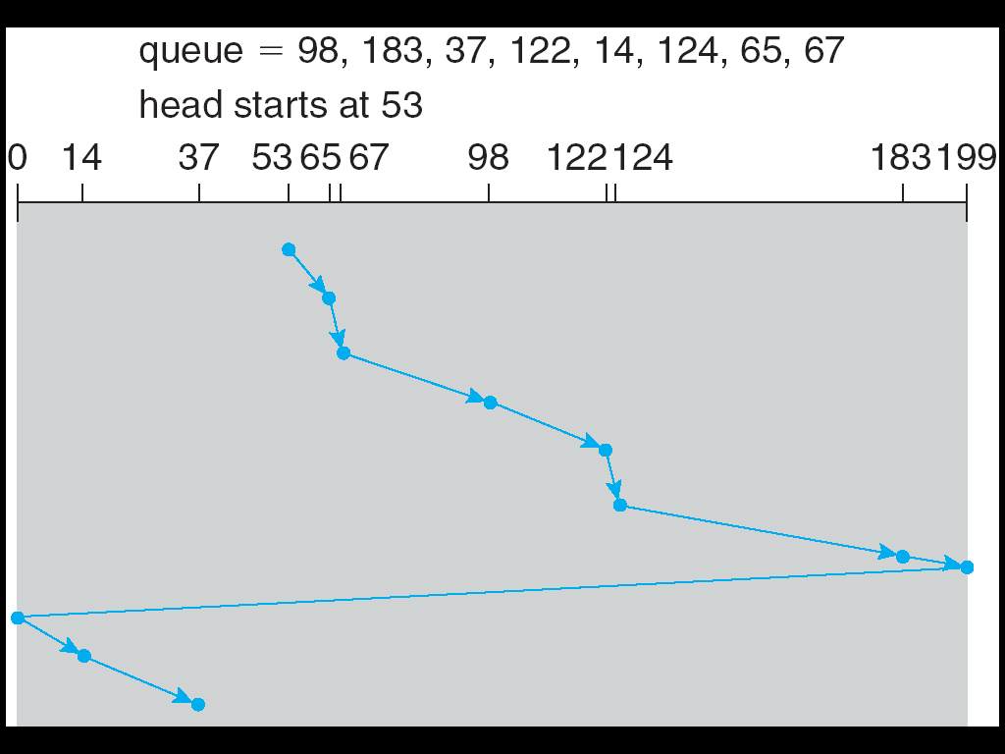
C-SCAN (Cont)
49

Slide 50
C-LOOK
Version of C-SCAN
Arm only goes as far as the last request in each direction, then reverses direction immediately, without first going all the way to the end of the disk
50

Slide 51
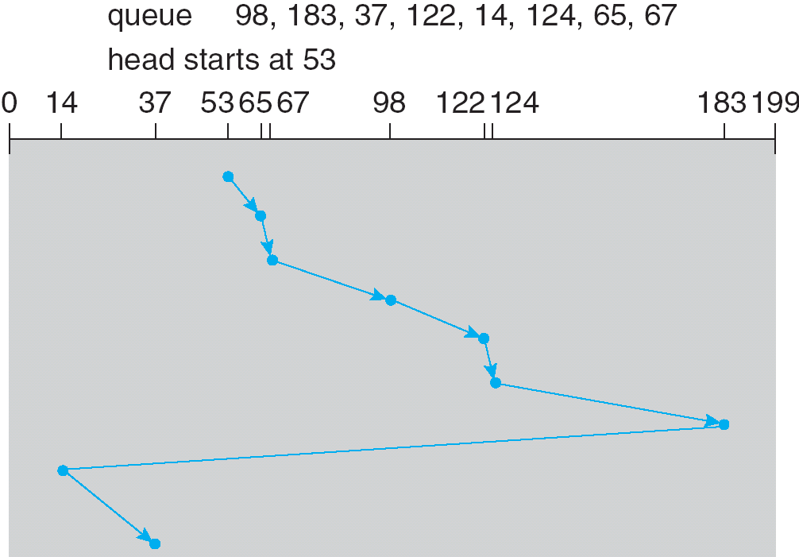
C-LOOK (Cont)
51

Slide 52
Selecting a Disk-Scheduling Algorithm
SSTF is common and has a natural appeal
SCAN and C-SCAN perform better for systems that place a heavy load on the disk
Performance depends on the number and types of requests
Requests for disk service can be influenced by the file-allocation method
The disk-scheduling algorithm should be written as a separate module of the operating system, allowing it to be replaced with a different algorithm if necessary
Either SSTF or LOOK is a reasonable choice for the default algorithm
52

Slide 53

Memory management

Slide 54
Memory management
Memory management is the functionality of an operating system which handles or manages primary memory and moves processes back and forth between main memory and disk during execution.
Memory management keeps track of each and every memory location, regardless of either it is allocated to some process or it is free. It checks how much memory is to be allocated to processes. It decides which process will get memory at what time. It tracks whenever some memory gets freed or unallocated and correspondingly it updates the status.

Slide 55
What is Memory Management?
Memory Management is the process of controlling and coordinating computer memory, assigning portions known as blocks to various running programs to optimize the overall performance of the system.

Slide 56
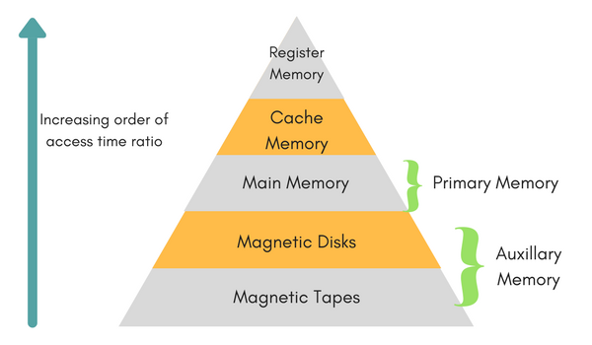
Memory Hierarchy

Slide 57
Memory Hierarchy
Registers are a type of computer memory used to quickly accept, store, and transfer data and instructions that are being used immediately by the CPU. The registers used by the CPU are often termed as Processor registers.
Cache Memory : Cache memory can also be found in the processor , it holds the chunk of data which are frequently used from main memory.
Main Memory :Main memory is the primary, internal workspace in the computer, commonly known as RAM (random access memory).

Slide 58

Memory Hierarchy
Magnetic Disks : A magnetic disk is a storage device that uses a magnetization process to write, rewrite and access data. It is covered with a magnetic coating and stores data in the form of tracks, spots and sectors. Hard disks, zip disks and floppy disks are common examples of magnetic disks.

Slide 59

Memory Hierarchy
Magnetic Tape :Magnetic tape is a medium for magnetic recording, made of a thin, magnetizable coating on a long, narrow strip of plastic film

Slide 60
Logical vs physical address space
Logical Address :
Address generated by CPU while a program is running is referred as Logical Address. The logical address is virtual as it does not exist physically. Hence, it is also called as Virtual Address.
Physical Address :
Physical Address identifies a physical location in a memory. MMU (Memory-Management Unit) computes the physical address for the corresponding logical address. MMU also uses logical address computing physical address.

Slide 61
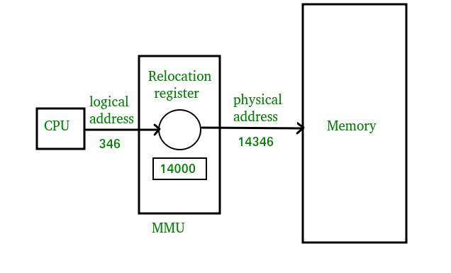

Slide 62
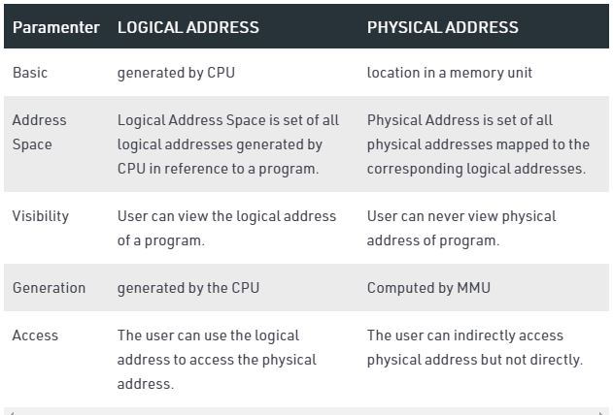

Slide 63
Static vs Dynamic Loading
The choice between Static or Dynamic Loading is to be made at the time of computer program being developed.
If you have to load your program statically, then at the time of compilation, the complete programs will be compiled and linked without leaving any external program or module dependency.
if you are writing a Dynamically loaded program, then your compiler will compile the program and for all the modules which you want to include dynamically, only references will be provided and rest of the work will be done at the time of execution.

Slide 64
Static vs Dynamic Linking
when static linking is used, the linker combines all other modules needed by a program into a single executable program to avoid any runtime dependency.
When dynamic linking is used, it is not required to link the actual module or library with the program, rather a reference to the dynamic module is provided at the time of compilation and linking. Dynamic Link Libraries (DLL) in Windows and Shared Objects in Unix are good examples of dynamic libraries.

Slide 65
Memory management with swapping
Swapping
Swapping is a mechanism in which a process can be swapped temporarily out of main memory (or move) to secondary storage (disk) and make that memory available to other processes. At some later time, the system swaps back the process from the secondary storage to main memory.

Slide 66
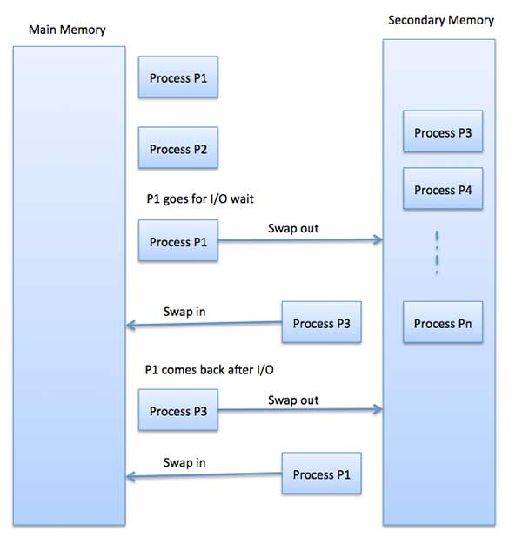
Memory management with swapping
Though performance is usually affected by swapping process but it helps in running multiple and big processes in parallel and that's the reason Swapping is also known as a technique for memory compaction.

Slide 67
Benefits of Swapping
It offers a higher degree of multiprogramming.
Allows dynamic relocation. For example, if address binding at execution time is being used, then processes can be swap in different locations. Else in case of compile and load time bindings, processes should be moved to the same location.
It helps to get better utilization of memory.
Minimum wastage of CPU time on completion so it can easily be applied to a priority-based scheduling method to improve its performance.

Slide 68
Memory management with Bitmaps
when memory is assigned dynamically , the OS must manage it.
in general there are two ways to keep track of memory usage.
memory management with bitmap.
memory management with linked list.

Slide 69
Memory management with Bitmaps
- Memory is divided into allocation units and each allocation unit has a bit in the bitmap. - If the bit is 0, the unit is free. - It requires less memory to store bit maps. - Searching a bitmap for a run of a given length is a slow operation.

Slide 70
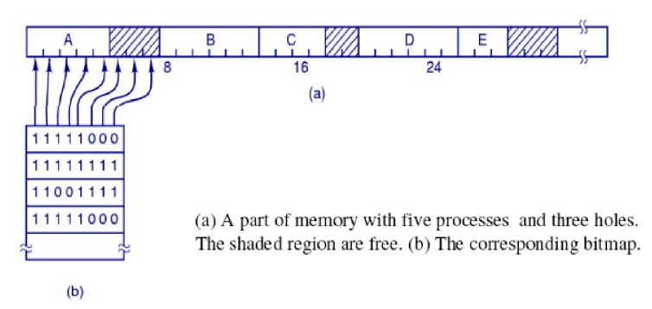
Memory management with Bitmaps

Slide 71
Memory management with Linked list
A linked list of allocated and free memory segments is maintained.
Each entry in a list specifies a hole or process, address at which it starts, length and pointer to next entry.
Process and hole are on a list sorted by address.

Slide 72
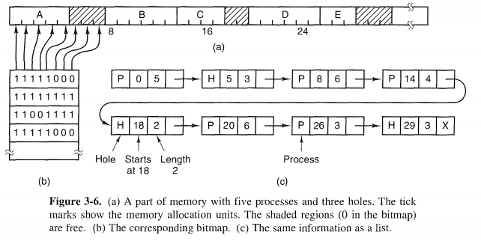
Memory management with Linked list

Slide 73
Memory management without swapping
In this mechanism Entire process remains in memory from start to finish and does not move.
The sum of the memory requirements of all jobs in the system cannot exceed the size of physical memory.
There are two models in this technique:
Mono-programming without swapping
Multiprogramming with fixed partitions

Slide 74
Mono-programming without swapping
In this scheme, it is allowed to run only one program at a time, sharing memory between program and OS.
When user provides command, the as copies requested program to memory form disk and executes it. As the program completes, the OS displays prompt character and waits for next command. When next command is provided, it beds new program into memory overwriting the previous program.

Slide 75
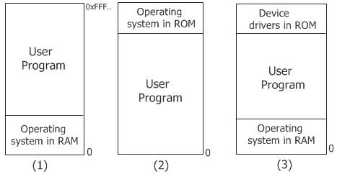
Mono-programming without swapping
The first model was used on very early computers.
The second model is used on some palmtop computers and embedded systems.
The third model is used by MS-DOS. The next command would load a new program into memory, overwriting the previous one.

Slide 76
Memory Allocation Techniques
Contiguous Storage Allocation
Fixed Partition Allocation
Variable Partition Allocation
Non-Contiguous
Paging
Segmentation

Slide 77
Multiprogramming with Fixed Partition
Multiprogramming increases CPU utilization by allowing multiple processes in memory at once so that when one process is blocked, another process can be use the CPU.
It can be achieved by dividing memory into ‘n’ partitions.
When any process requests memory, it can be put into input queue for the smallest partition large enough to hold it.
Any space in a partition which are not used by a process are wasted.
It can also be done by maintaining a single queue.

Slide 78
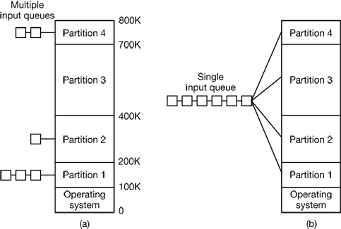

Slide 79
Advantages and disadvantages of fixed partition
Advantages:
Easy to implement.
Little OS overhead : needs indirect processing power.
Disadvantages
Internal Fragmentation : same amount of memory portioned.
Limitation on degree of Multiprogramming
Limit process Size : process cannot run sufficiently.

Slide 80
Multiprogramming with Variable Partition
The memory is partitioned dynamically when process comes and goes.
The number, location and size of partitions vary.
Swapping can crate multiple holes in memory and it can be combined into one big hole by moving all processes download. This is called memory compaction. (coalescing )adjacent hole.
memory compaction requires a lot of CPU time

Slide 81
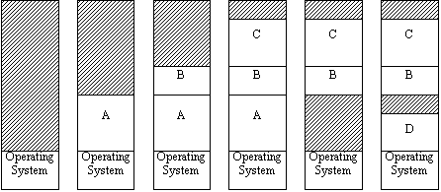
Multiprogramming with Variable Partition

Slide 82
Advantages and disadvantages of variable partition
Advantages
No internal fragmentation
No restriction on degree of multiprogramming
No limitation on the size of process
Disadvantages
Difficult to implement
Need external fragmantation of memory if space is unavailable in main memory.

Slide 83
Problems with Multiprogramming:
1) Relocation: It is the method of shifting a user program frame line memory location to another. To achieve relocation, it can be equipped with address of the start of its partition and limit register is loaded with length of partition
2) protection: When absolute memory address is used, a malicious program can read or write any ward in memory.

Slide 84
Relocation and Protection
Protection : Once you can have two programs in memory at the same time there is a danger that one program can write to the address space of another program. This is obviously dangerous and should be avoided.
Relocation : When a program is run it does not know in advance what location it will be loaded at. Therefore, the program cannot simply generate static addresses (e.g. from jump instructions). Instead, they must be made relative to where the program has been loaded.

Slide 85
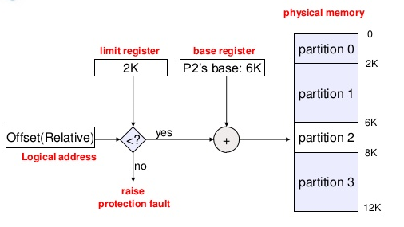

Slide 86
Fragmentation
Fragmentation is an unwanted problem where the memory blocks cannot be allocated to the processes due to their small size and the blocks remain unused.
It can also be understood as when the processes are loaded and removed from the memory they create free space or hole in the memory and these small blocks cannot be allocated to new upcoming processes and results in inefficient use of memory.
Basically, there are two types of fragmentation:
Internal Fragmentation
External Fragmentation

Slide 87

Internal Fragmentation
In this fragmentation, the process is allocated a memory block of size more than the size of that process. Due to this some part of the memory is left unused and this cause internal fragmentation.

Slide 88
Internal Fragmentation
Example: Suppose there is fixed partitioning (i.e. the memory blocks are of fixed sizes) is used for memory allocation in RAM. These sizes are 2MB, 4MB, 4MB, 8MB. Some part of this RAM is occupied by the Operating System (OS).
Now, suppose a process P1 of size 3MB comes and it gets memory block of size 4MB. So, the 1MB that is free in this block is wasted and this space can’t be utilized for allocating memory to some other process. This is called internal fragmentation.

Slide 89
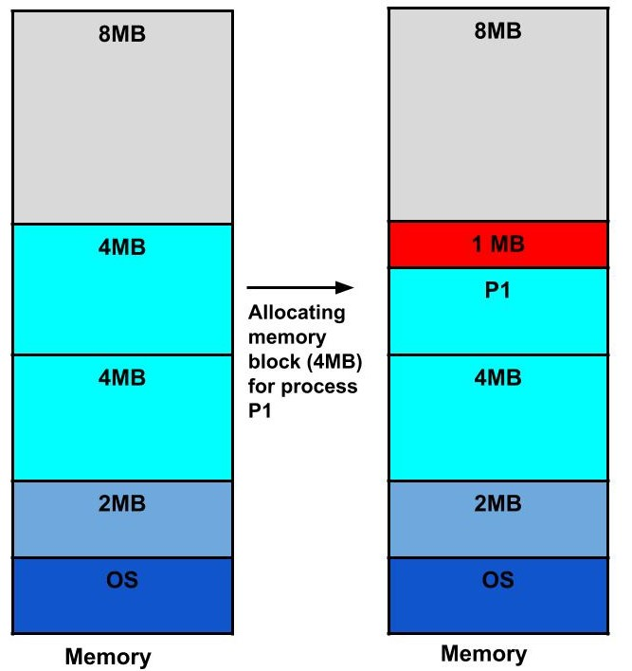
Internal Fragmentation

Slide 90

How to remove internal fragmentation?
This problem is occurring because we have fixed the sizes of the memory blocks. This problem can be removed if we use dynamic partitioning for allocating space to the process. In dynamic partitioning, the process is allocated only that much amount of space which is required by the process. So, there is no internal fragmentation.

Slide 91

External Fragmentation
In this fragmentation, although we have total space available that is needed by a process still we are not able to put that process in the memory because that space is not contiguous. This is called external fragmentation.

Slide 92
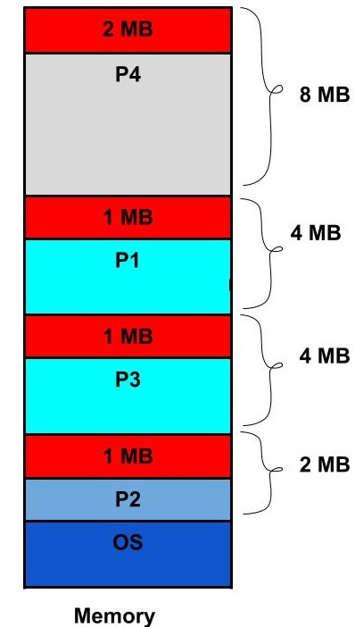
External Fragmentation
Example: Suppose in the above example, if three new processes P2, P3, and P4 come of sizes 2MB, 3MB, and 6MB respectively. Now, these processes get memory blocks of size 2MB, 4MB and 8MB respectively allocated.
So, now if we closely analyze this situation then process P3 (unused 1MB)and P4(unused 2MB) are again causing internal fragmentation. So, a total of 4MB (1MB (due to process P1) + 1MB (due to process P3) + 2MB (due to process P4)) is unused due to internal fragmentation.
Now, suppose a new process of 4 MB comes. Though we have a total space of 4MB still we can’t allocate this memory to the process. This is called external fragmentation.

Slide 93

How to remove external fragmentation?
This problem is occurring because we are allocating memory continuously to the processes. So, if we remove this condition external fragmentation can be reduced. This is what done in paging & segmentation(non-contiguous memory allocation techniques) where memory is allocated non-contiguously to the processes. We will learn about paging and segmentation in the next blog.

Slide 94

Memory Allocation strategies
Memory allocation is the process of assigning blocks of memory on request.
Typically the allocator receives memory from OS in a small blocks that it must divide up to satisfy the requests for smaller blocks.
Several algorithms are used to allocate the memory for newly created process.

Slide 95
Memory Allocation strategies
The popular strategies of memory allocation for newly created processes by using linked list are :
First Fit
Next Fit
Best Fit
Worst Fit
Quick Fit

Slide 96
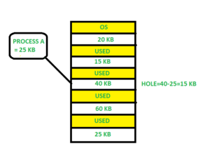
First Fit
In the first fit, the partition is allocated which is the first sufficient block from the top of Main Memory. It scans memory from the beginning and chooses the first available block that is large enough. Thus it allocates the first hole that is large enough.

Slide 97
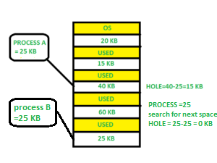
Next Fit
Next fit is similar to the first fit but it will search for the first sufficient partition from the last allocation point.

Slide 98
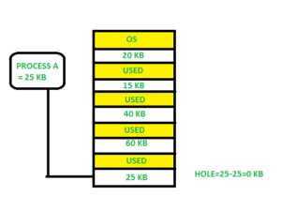
Best Fit
Allocate the process to the partition which is the first smallest sufficient partition among the free available partition. It searches the entire list of holes to find the smallest hole whose size is greater than or equal to the size of the process.

Slide 99
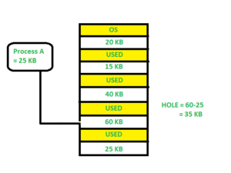
Worst Fit
Allocate the process to the partition which is the largest sufficient among the freely available partitions available in the main memory. It is opposite to the best-fit algorithm. It searches the entire list of holes to find the largest hole and allocate it to process.

Slide 100

Quick Fit
The quick fit algorithm suggests maintaining the different lists of frequently used sizes. Although, it is not practically suggestible because the procedure takes so much time to create the different lists and then expending the holes to load a process.

Slide 101

Which one is Best Algorithm??
The first fit algorithm is the best algorithm among all because
It takes lesser time compare to the other algorithms.
It produces bigger holes that can be used to load other processes later on.
It is easiest to implement.

Slide 102
Exercise: Consider the requests from processes in given order 300K, 25K, 125K, and 50K. Let there be two blocks of memory available of size 150K followed by a block size 350K.
Best Fit: 300K is allocated from a block of size 350K. 50 is left in the block. 25K is allocated from the remaining 50K block. 25K is left in the block. 125K is allocated from 150 K block. 25K is left in this block also. 50K can’t be allocated even if there is 25K + 25K space available.
First Fit: 300K request is allocated from 350K block, 50K is left out. 25K is be allocated from the 150K block, 125K is left out. Then 125K and 50K are allocated to the remaining left out partitions. So, the first fit can handle requests.
So option B is the correct choice.

Slide 103
Assignment:
What is memory allocation? Explain the difference between Contiguous and Non-contiguous Memory Allocation.
Ans: https://www.includehelp.com/operating-systems/contiguous-and-non-contiguous-memory-allocation.aspx

Slide 104
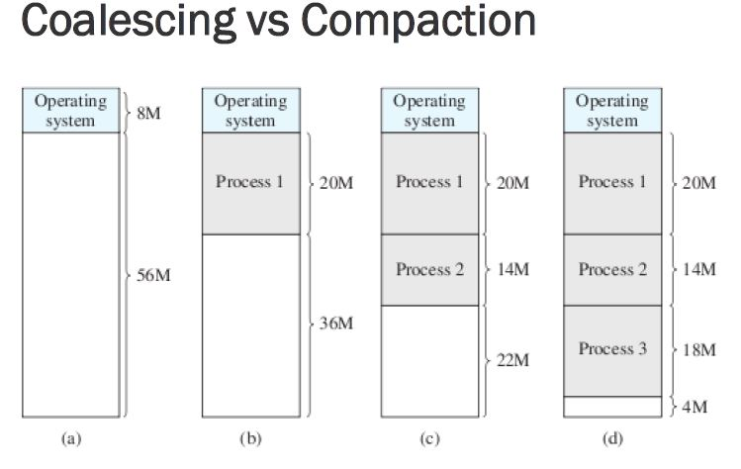

Slide 105
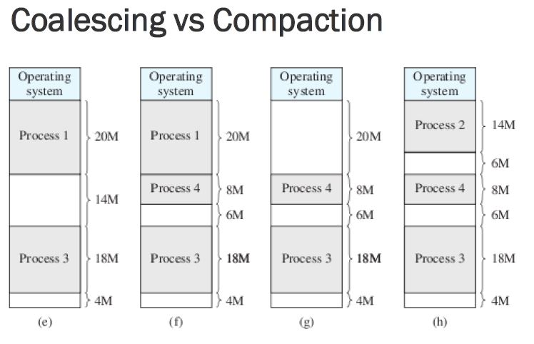

Slide 106
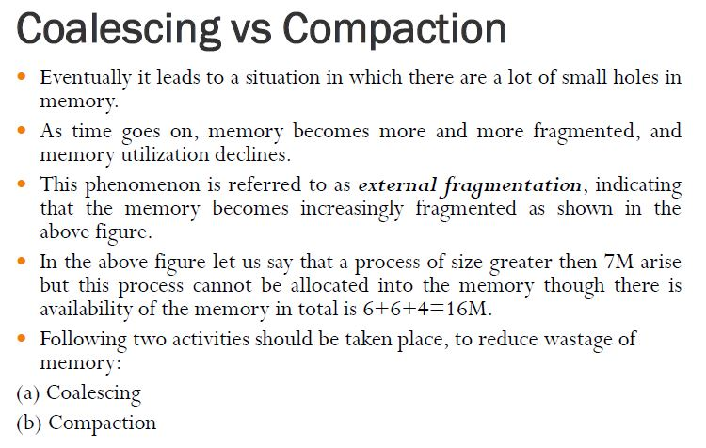

Slide 107
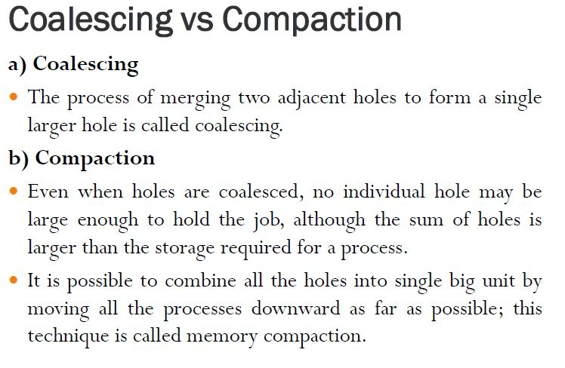

Slide 108
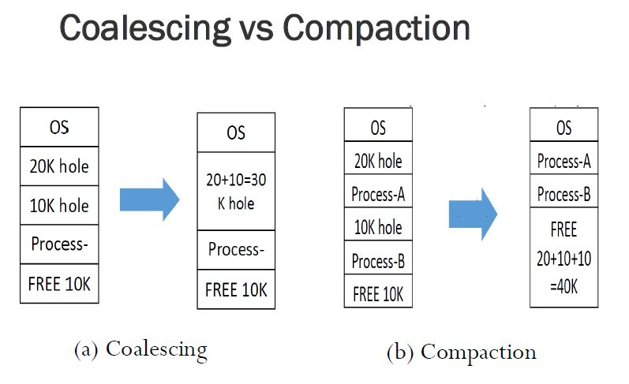

Slide 109
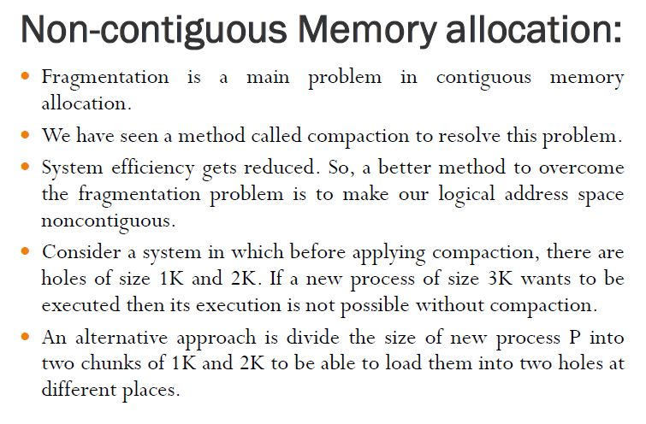

Slide 110
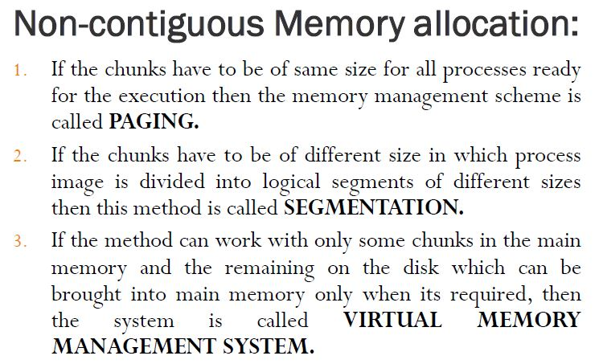

Slide 111

Thank you

Slide 112
Memory management

Slide 113
Memory management
Memory management is the functionality of an operating system which handles or manages primary memory and moves processes back and forth between main memory and disk during execution.
Memory management keeps track of each and every memory location, regardless of either it is allocated to some process or it is free. It checks how much memory is to be allocated to processes. It decides which process will get memory at what time. It tracks whenever some memory gets freed or unallocated and correspondingly it updates the status.

Slide 114
What is Memory Management?
Memory Management is the process of controlling and coordinating computer memory, assigning portions known as blocks to various running programs to optimize the overall performance of the system.

Slide 115
Memory Hierarchy

Slide 116
Memory Hierarchy
Registers are a type of computer memory used to quickly accept, store, and transfer data and instructions that are being used immediately by the CPU. The registers used by the CPU are often termed as Processor registers.
Cache Memory : Cache memory can also be found in the processor , it holds the chunk of data which are frequently used from main memory.
Main Memory :Main memory is the primary, internal workspace in the computer, commonly known as RAM (random access memory).

Slide 117
Memory Hierarchy
Magnetic Disks : A magnetic disk is a storage device that uses a magnetization process to write, rewrite and access data. It is covered with a magnetic coating and stores data in the form of tracks, spots and sectors. Hard disks, zip disks and floppy disks are common examples of magnetic disks.

Slide 118
Memory Hierarchy
Magnetic Tape :Magnetic tape is a medium for magnetic recording, made of a thin, magnetizable coating on a long, narrow strip of plastic film

Slide 119
Logical vs physical address space
Logical Address :
Address generated by CPU while a program is running is referred as Logical Address. The logical address is virtual as it does not exist physically. Hence, it is also called as Virtual Address.
Physical Address :
Physical Address identifies a physical location in a memory. MMU (Memory-Management Unit) computes the physical address for the corresponding logical address. MMU also uses logical address computing physical address.

Slide 122
Static vs Dynamic Loading
The choice between Static or Dynamic Loading is to be made at the time of computer program being developed.
If you have to load your program statically, then at the time of compilation, the complete programs will be compiled and linked without leaving any external program or module dependency.
if you are writing a Dynamically loaded program, then your compiler will compile the program and for all the modules which you want to include dynamically, only references will be provided and rest of the work will be done at the time of execution.

Slide 123
Static vs Dynamic Linking
when static linking is used, the linker combines all other modules needed by a program into a single executable program to avoid any runtime dependency.
When dynamic linking is used, it is not required to link the actual module or library with the program, rather a reference to the dynamic module is provided at the time of compilation and linking. Dynamic Link Libraries (DLL) in Windows and Shared Objects in Unix are good examples of dynamic libraries.

Slide 124
Memory management with swapping
Swapping
Swapping is a mechanism in which a process can be swapped temporarily out of main memory (or move) to secondary storage (disk) and make that memory available to other processes. At some later time, the system swaps back the process from the secondary storage to main memory.

Slide 125
Memory management with swapping
Though performance is usually affected by swapping process but it helps in running multiple and big processes in parallel and that's the reason Swapping is also known as a technique for memory compaction.

Slide 126
Benefits of Swapping
It offers a higher degree of multiprogramming.
Allows dynamic relocation. For example, if address binding at execution time is being used, then processes can be swap in different locations. Else in case of compile and load time bindings, processes should be moved to the same location.
It helps to get better utilization of memory.
Minimum wastage of CPU time on completion so it can easily be applied to a priority-based scheduling method to improve its performance.

Slide 127
Memory management with Bitmaps
when memory is assigned dynamically , the OS must manage it.
in general there are two ways to keep track of memory usage.
memory management with bitmap.
memory management with linked list.

Slide 128
Memory management with Bitmaps
- Memory is divided into allocation units and each allocation unit has a bit in the bitmap. - If the bit is 0, the unit is free. - It requires less memory to store bit maps. - Searching a bitmap for a run of a given length is a slow operation.

Slide 129
Memory management with Bitmaps

Slide 130
Memory management with Linked list
A linked list of allocated and free memory segments is maintained.
Each entry in a list specifies a hole or process, address at which it starts, length and pointer to next entry.
Process and hole are on a list sorted by address.

Slide 131
Memory management with Linked list

Slide 132
Memory management without swapping
In this mechanism Entire process remains in memory from start to finish and does not move.
The sum of the memory requirements of all jobs in the system cannot exceed the size of physical memory.
There are two models in this technique:
Mono-programming without swapping
Multiprogramming with fixed partitions

Slide 133
Mono-programming without swapping
In this scheme, it is allowed to run only one program at a time, sharing memory between program and OS.
When user provides command, the as copies requested program to memory form disk and executes it. As the program completes, the OS displays prompt character and waits for next command. When next command is provided, it beds new program into memory overwriting the previous program.

Slide 134
Mono-programming without swapping
The first model was used on very early computers.
The second model is used on some palmtop computers and embedded systems.
The third model is used by MS-DOS. The next command would load a new program into memory, overwriting the previous one.

Slide 135
Memory Allocation Techniques
Contiguous Storage Allocation
Fixed Partition Allocation
Variable Partition Allocation
Non-Contiguous
Paging
Segmentation

Slide 136
Multiprogramming with Fixed Partition
Multiprogramming increases CPU utilization by allowing multiple processes in memory at once so that when one process is blocked, another process can be use the CPU.
It can be achieved by dividing memory into ‘n’ partitions.
When any process requests memory, it can be put into input queue for the smallest partition large enough to hold it.
Any space in a partition which are not used by a process are wasted.
It can also be done by maintaining a single queue.

Slide 138
Advantages and disadvantages of fixed partition
Advantages:
Easy to implement.
Little OS overhead : needs indirect processing power.
Disadvantages
Internal Fragmentation : same amount of memory portioned.
Limitation on degree of Multiprogramming
Limit process Size : process cannot run sufficiently.

Slide 139
Multiprogramming with Variable Partition
The memory is partitioned dynamically when process comes and goes.
The number, location and size of partitions vary.
Swapping can crate multiple holes in memory and it can be combined into one big hole by moving all processes download. This is called memory compaction. (coalescing )adjacent hole.
memory compaction requires a lot of CPU time

Slide 140
Multiprogramming with Variable Partition

Slide 141
Advantages and disadvantages of variable partition
Advantages
No internal fragmentation
No restriction on degree of multiprogramming
No limitation on the size of process
Disadvantages
Difficult to implement
Need external fragmantation of memory if space is unavailable in main memory.

Slide 142
Problems with Multiprogramming:
1) Relocation: It is the method of shifting a user program frame line memory location to another. To achieve relocation, it can be equipped with address of the start of its partition and limit register is loaded with length of partition
2) protection: When absolute memory address is used, a malicious program can read or write any ward in memory.

Slide 143
Relocation and Protection
Protection : Once you can have two programs in memory at the same time there is a danger that one program can write to the address space of another program. This is obviously dangerous and should be avoided.
Relocation : When a program is run it does not know in advance what location it will be loaded at. Therefore, the program cannot simply generate static addresses (e.g. from jump instructions). Instead, they must be made relative to where the program has been loaded.

Slide 145
Fragmentation
Fragmentation is an unwanted problem where the memory blocks cannot be allocated to the processes due to their small size and the blocks remain unused.
It can also be understood as when the processes are loaded and removed from the memory they create free space or hole in the memory and these small blocks cannot be allocated to new upcoming processes and results in inefficient use of memory.
Basically, there are two types of fragmentation:
Internal Fragmentation
External Fragmentation

Slide 146
Internal Fragmentation
In this fragmentation, the process is allocated a memory block of size more than the size of that process. Due to this some part of the memory is left unused and this cause internal fragmentation.

Slide 147
Internal Fragmentation
Example: Suppose there is fixed partitioning (i.e. the memory blocks are of fixed sizes) is used for memory allocation in RAM. These sizes are 2MB, 4MB, 4MB, 8MB. Some part of this RAM is occupied by the Operating System (OS).
Now, suppose a process P1 of size 3MB comes and it gets memory block of size 4MB. So, the 1MB that is free in this block is wasted and this space can’t be utilized for allocating memory to some other process. This is called internal fragmentation.

Slide 148
Internal Fragmentation

Slide 149
How to remove internal fragmentation?
This problem is occurring because we have fixed the sizes of the memory blocks. This problem can be removed if we use dynamic partitioning for allocating space to the process. In dynamic partitioning, the process is allocated only that much amount of space which is required by the process. So, there is no internal fragmentation.

Slide 150
External Fragmentation
In this fragmentation, although we have total space available that is needed by a process still we are not able to put that process in the memory because that space is not contiguous. This is called external fragmentation.

Slide 151
External Fragmentation
Example: Suppose in the above example, if three new processes P2, P3, and P4 come of sizes 2MB, 3MB, and 6MB respectively. Now, these processes get memory blocks of size 2MB, 4MB and 8MB respectively allocated.
So, now if we closely analyze this situation then process P3 (unused 1MB)and P4(unused 2MB) are again causing internal fragmentation. So, a total of 4MB (1MB (due to process P1) + 1MB (due to process P3) + 2MB (due to process P4)) is unused due to internal fragmentation.
Now, suppose a new process of 4 MB comes. Though we have a total space of 4MB still we can’t allocate this memory to the process. This is called external fragmentation.

Slide 152
How to remove external fragmentation?
This problem is occurring because we are allocating memory continuously to the processes. So, if we remove this condition external fragmentation can be reduced. This is what done in paging & segmentation(non-contiguous memory allocation techniques) where memory is allocated non-contiguously to the processes. We will learn about paging and segmentation in the next blog.

Slide 153
Memory Allocation strategies
Memory allocation is the process of assigning blocks of memory on request.
Typically the allocator receives memory from OS in a small blocks that it must divide up to satisfy the requests for smaller blocks.
Several algorithms are used to allocate the memory for newly created process.

Slide 154
Memory Allocation strategies
The popular strategies of memory allocation for newly created processes by using linked list are :
First Fit
Next Fit
Best Fit
Worst Fit
Quick Fit

Slide 155
First Fit
In the first fit, the partition is allocated which is the first sufficient block from the top of Main Memory. It scans memory from the beginning and chooses the first available block that is large enough. Thus it allocates the first hole that is large enough.

Slide 156
Next Fit
Next fit is similar to the first fit but it will search for the first sufficient partition from the last allocation point.

Slide 157
Best Fit
Allocate the process to the partition which is the first smallest sufficient partition among the free available partition. It searches the entire list of holes to find the smallest hole whose size is greater than or equal to the size of the process.

Slide 158
Worst Fit
Allocate the process to the partition which is the largest sufficient among the freely available partitions available in the main memory. It is opposite to the best-fit algorithm. It searches the entire list of holes to find the largest hole and allocate it to process.

Slide 159
Quick Fit
The quick fit algorithm suggests maintaining the different lists of frequently used sizes. Although, it is not practically suggestible because the procedure takes so much time to create the different lists and then expending the holes to load a process.

Slide 160
Which one is Best Algorithm??
The first fit algorithm is the best algorithm among all because
It takes lesser time compare to the other algorithms.
It produces bigger holes that can be used to load other processes later on.
It is easiest to implement.

Slide 161
Exercise: Consider the requests from processes in given order 300K, 25K, 125K, and 50K. Let there be two blocks of memory available of size 150K followed by a block size 350K.
Best Fit: 300K is allocated from a block of size 350K. 50 is left in the block. 25K is allocated from the remaining 50K block. 25K is left in the block. 125K is allocated from 150 K block. 25K is left in this block also. 50K can’t be allocated even if there is 25K + 25K space available.
First Fit: 300K request is allocated from 350K block, 50K is left out. 25K is be allocated from the 150K block, 125K is left out. Then 125K and 50K are allocated to the remaining left out partitions. So, the first fit can handle requests.
So option B is the correct choice.

Slide 162
Assignment:
What is memory allocation? Explain the difference between Contiguous and Non-contiguous Memory Allocation.
Ans: https://www.includehelp.com/operating-systems/contiguous-and-non-contiguous-memory-allocation.aspx

Slide 170
Thank you

Slide 171
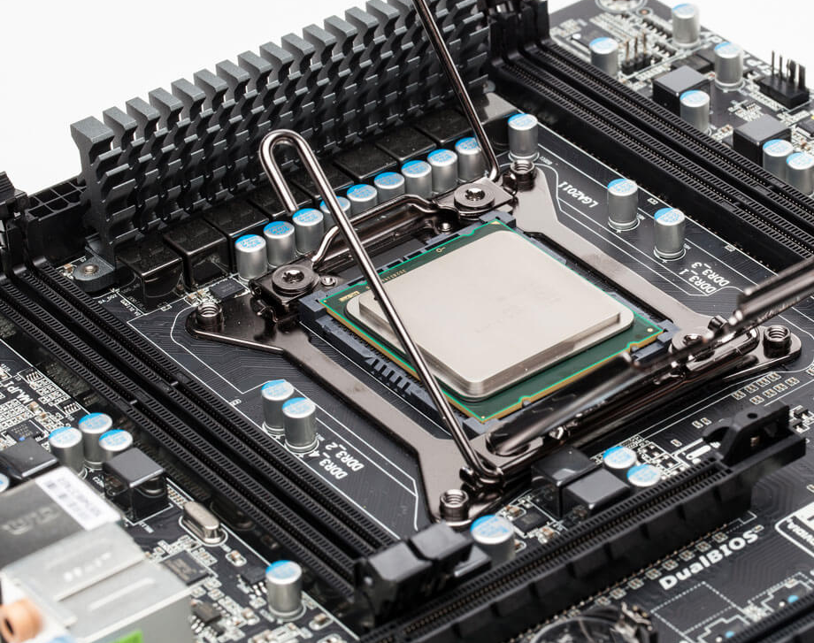
Process Management
Chapter Two
Notes:
NOTE: Want a different image on this slide? Select the picture and delete it. Now click the Pictures icon in the placeholder to insert your own image.

Slide 172
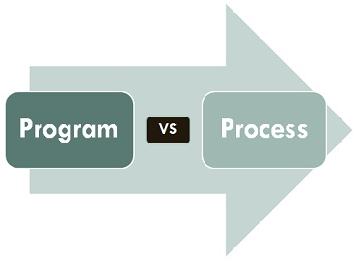
PROCESS
A process is an instance of a program running in a computer.
It is close in meaning to task, a term used in some OS.
A program by itself is not a process; a program is a passive entity, such as a file containing a list of instructions stored on disks. (often called an executable file)
A program becomes a process when an executable file is loaded into memory and executed.

Slide 173

Program is an executable file containing the set of instructions written to perform a specific job on our computer.
A program is piece of code which may be a single line or millions of lines.
Program are not stored on the primary memory on our computer. They are stored on a disk or secondary memory of our computer

Slide 174
Multiprogramming
Multiprogramming is also the ability of an operating system to execute more than one program on a single processor machine.
More than one task/program/job/process can reside into the main memory at one point of time.

Slide 175
Advantage
High CPU utilization.
The system looks fast as all the tasks runs in parallel.

Slide 176
Disadvantage
CPU scheduling is required.
To accommodate several jobs in memory, memory management is essential.

Slide 177
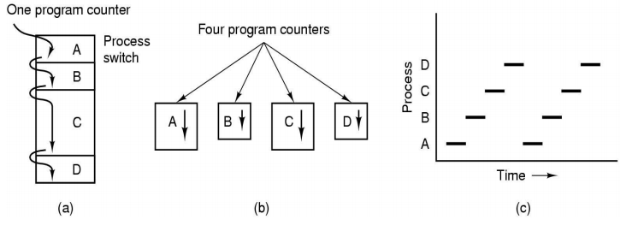
Process Model
In this model, all the runnable software in the computer, sometimes including operating system, is organized into number of sequential processes.
Multiprogramming model
Conceptual model
Only one program at a time

Slide 178
When a program is loaded into the memory and it becomes a process, it can be divided into four sections ─
stack
Heap
Text
data

Slide 179
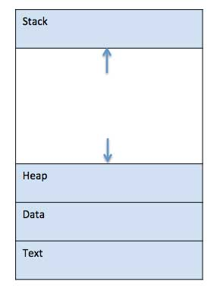

Slide 180
Stack
The process Stack contains the temporary data such as method/function parameters, return address and local variables.
Heap
This is dynamically allocated memory to a process during its run time.

Slide 181
Text
This includes the current activity represented by the value of Program Counter and the contents of the processor's registers.
Data
This section contains the global and static variables.

Slide 182
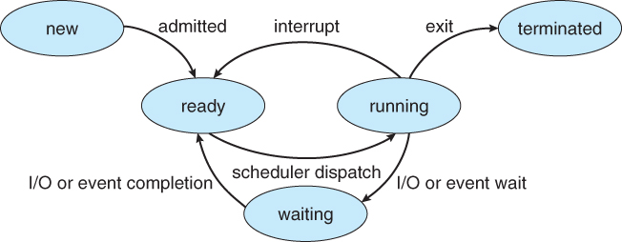
STATES OF PROCESS

Slide 183
START
In this step, the process is about to be created but not yet created, it is the program which is present in secondary memory that will be picked up by OS to create the process.

Slide 184
READY
The process is waiting to be assigned to a processor.
Ready processes are waiting to have the processor allocated to them by the operating system so that they can run.
Process may come into this state after Start state or while running it by but interrupted by the scheduler to assign CPU to some other process.

Slide 185
RUNNING
Once the process has been assigned to a processor by the OS scheduler, the process state is set to running and the processor executes its instructions

Slide 186
WAITING
Whenever the process requests access to I/O or needs input from the user or needs access to a critical region(the lock for which is already acquired) it enters the blocked or wait state.
The process continues to wait in the main memory and does not require CPU. Once the I/O operation is completed the process goes to the ready state.

Slide 187
TERMINATED
Once the process finishes its execution, or it is terminated by the operating system, it is moved to the terminated state where it waits to be removed from main memory.

Slide 188
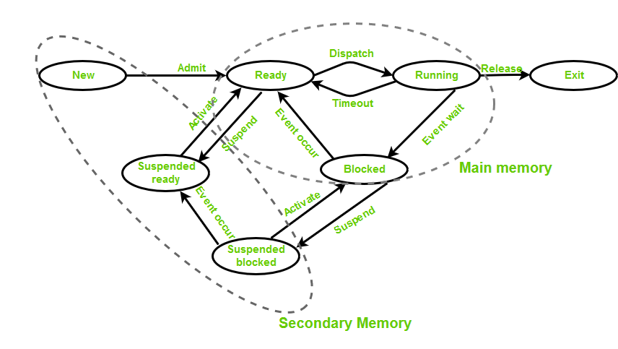

Slide 189
PROCESS CONTROL BLOCK

Slide 190
PROCESS CONTROL BLOCK
process control block (PCB) is used to track the process’s execution status.
A process control block (PCB) contains information about the process, i.e. registers, quantum, priority, etc.

Slide 191
FUNCTIONS
Naming the process
State of the process
Resources allocated to the process
Memory allocated to the process
Scheduling information
Input / output devices associated with process

Slide 192
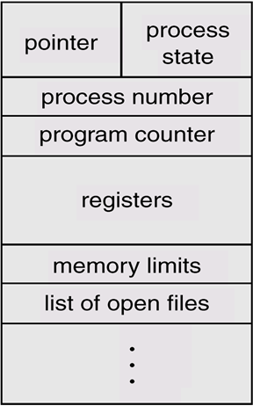

Slide 193
Process Control Block
Pointer
It is a stack pointer which is required to be saved when the process is switched from one state to another to retain the current position of the process.
Process state
It stores the respective state of the process.
Process number
Every process is assigned with a unique id known as process ID or PID which stores the process identifier.

Slide 194
Program counter
It stores the counter which contains the address of the next instruction that is to be executed for the process.
Register
These are the CPU registers which includes: accumulator, base, registers and general purpose registers.
Memory limits
This field contains the information about memory management system used by operating system. This may include the page tables, segment tables etc.
Open files list
This information includes the list of files opened for a process.

Slide 195





THREADS

Slide 196
WHAT IS THREAD?
A thread is the smallest unit of processing that can be performed in an OS.
A thread is also called a lightweight process. Threads provide a way to improve application performance through quasi parallel.
A thread exists within a process - that is, a single process may contain multiple threads.
Each thread belongs to exactly one process and no thread can exist outside a process.
It shares with other threads belonging to the same process its code section, data section, and other operating system resources, such as open files and signals.

Slide 197
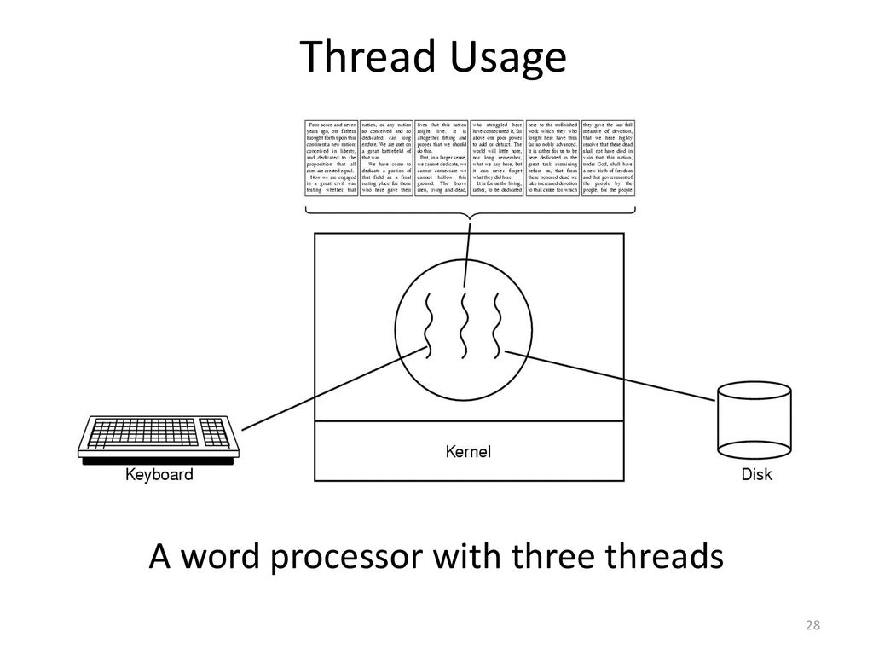

Slide 198
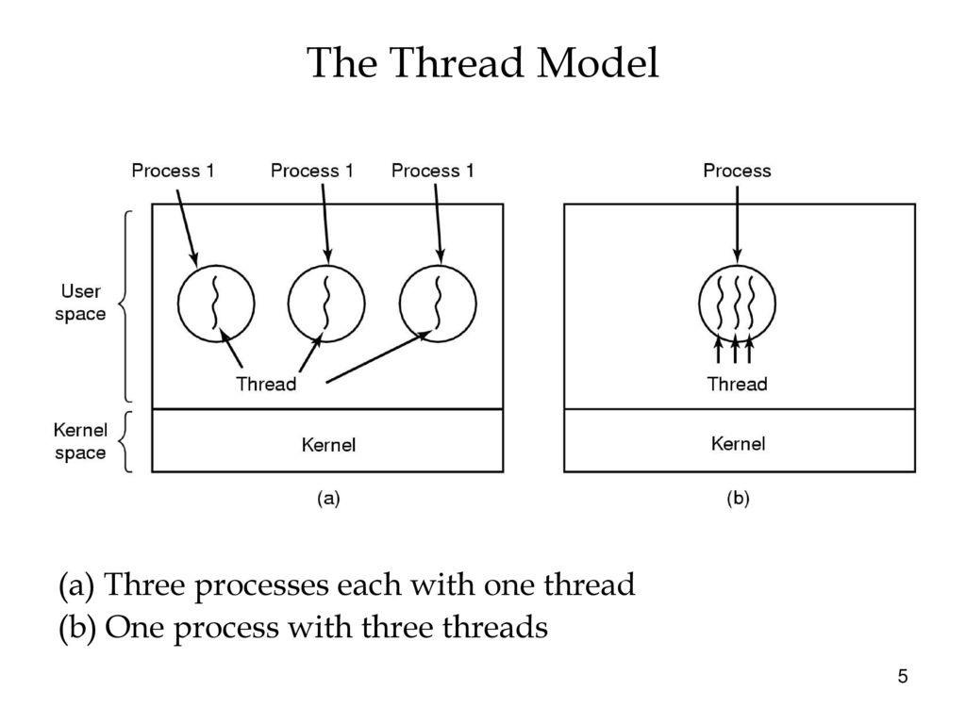

Slide 199
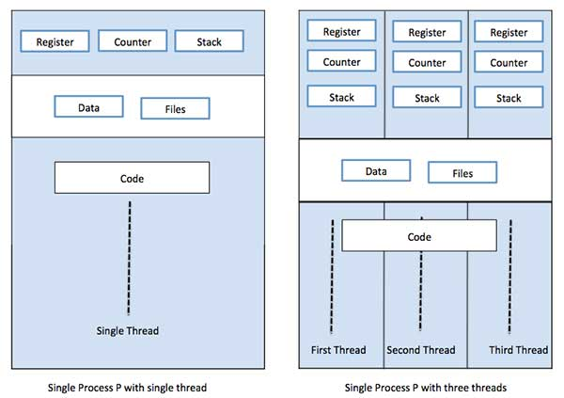
SINGLE THREAD AND MULTIPLE THREAD

Slide 200
PROCESS VS THREAD
Threads within the same process run in a shared memory space, while processes run in separate memory spaces.
Threads are not independent of one another like processes are NOT.
threads share with other threads their code section, data section, and OS resources (like open files and signals). But, like process, a thread has its own program counter (PC), register set, and stack space.

Slide 201
PROCESS VS THREAD
All threads of a program are logically contained within a process.
A process is heavy weighted, but a thread is light weighted.
A program is an isolated execution unit whereas thread is not isolated and shares memory.
A thread cannot have an individual existence; it is attached to a process. On the other hand, a process can exist individually.
At the time of expiration of a thread, its associated stack could be recovered as every thread has its own stack.

Slide 202
THREAD COTROL BLOCK
Very similar to Process Control Blocks (PCBs) which represents processes, Thread Control Blocks (TCBs) represents threads generated in the system. It contains information about the threads, such as its ID and states.

Slide 203
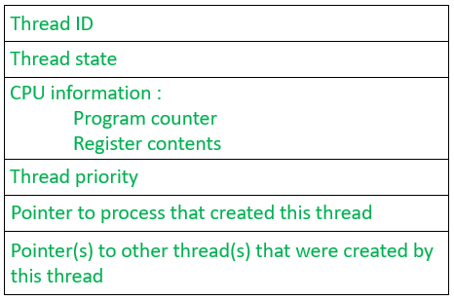

Slide 204
Thread ID: It is a unique identifier assigned by the Operating System to the thread when it is being created.
Thread states: These are the states of the thread which changes as the thread progresses through the system
CPU information: It includes everything that the OS needs to know about, such as how far the thread has progressed and what data is being used.

Slide 205
Thread Priority: It indicates the weight (or priority) of the thread over other threads which helps the thread scheduler to determine which thread should be selected next from the READY queue.
A pointer which points to the process which triggered the creation of this thread.

Slide 206
Two main ways to implement a threads package
User space thread
Kernel space thread

Slide 207
Types of Thread
User Space Threads
User managed threads.
Kernel Space Threads
Operating System managed threads acting on kernel, an operating system core.

Slide 208
User Space Threads
User level thread implement in user level libraries, so thread switching does not need to call operating system and to cause interrupt to the kernel.
The kernel knows nothing about user level threads and manages them as if they were single-threaded process.

Slide 209
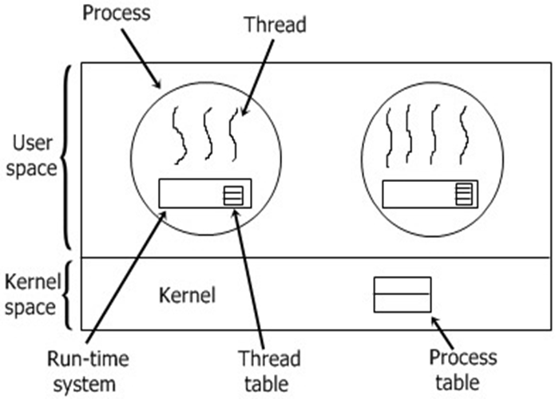

Slide 210
Advantages of ULT
User level threads does not require modification to operating system and are managed by user library.
User level threads are fast and efficient.
Context switching is fast.

Slide 211
Disadvantages of ULT
There is a lack of coordination between threads and operating system kernel.
ULT require non-blocking system call (i.e. Multithreaded kernel)

Slide 212
Kernel Level Threads (KLT)
In this method, the kernel knows about and manages the threads. No runtime system is needed in this case. Operating system kernel provides system call to create and manage threads.

Slide 213
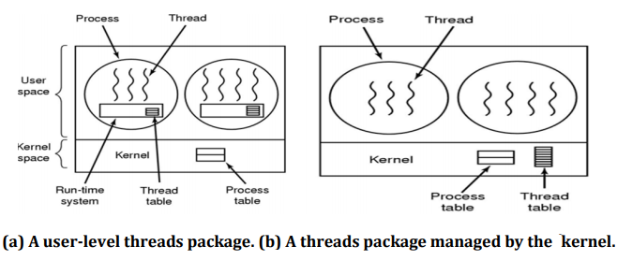

Slide 214
Advantages of KLT
Kernel can simultaneously schedule multiple threads from the same process.
If one thread in a process is blocked the kernel can schedule another thread of the same process.
Kernel routines themselves can multithreaded.

Slide 215
Disadvantages of KLT
Kernel thread are generally slower to create and manage than the user threads.
Kernel requires Thread Control Block (TCB) for each thread in the pool, hence complexity increases.

Slide 216
Operation on process

Slide 217
OPERATION ON PROCESS
Process Creation
Process Preemption
Process Blocking
Process Termination

Slide 218
Process Creation
Process creation means the construction of a new process for the execution. This might be performed by system, user or old process itself.
There are several events that leads to the process creation.
When we start the computer, system creates several background processes.
A user may request to create a new process.
A process can create a new process itself while executing.
Batch system takes initiation of a batch job.

Slide 219
Process Preemption
When a timeout occurs that means the process hadn’t been terminated in the allotted time interval and next process is ready to execute, then the operating system preempts the process. This operation is only valid where CPU scheduling supports preemption.

Slide 220
Process Blocking
When a process invokes an input-output system call that blocks the process and operating system put in block mode.

Slide 221
Process Termination
Process termination is the activity of ending the process.
Process completes its execution fully and it indicates to the OS that it has finished.
Operating system itself terminates the process due to service errors.
There may be problem in hardware that terminates the process.
One process can be terminated by another process.

Slide 222
INTER PROCESS COMMUNICATION
Inter-process communication (IPC) refers specifically to the mechanisms an operating system provides to allow the processes to manage shared data.
Issues for inter-process communication
Output of one process must be passed to the second process.
Two or more process get in each other's way.
Concerns proper sequencing when dependencies are present

Slide 223
Processes executing concurrently in the operating system may be either independent process or co-operating process.
Independent process:
A process is independent if it can't affect or be affected by another process.
Co-operating Process:
A process is co-operating if it can affect other or be affected by the other process.
Any process that shares data with other process is called cooperating process.

Slide 224
There are several reasons for providing an environment that allow process cooperation:
Information sharing
Computation speedup
Modularity
Convenience

Slide 225
Information sharing
Sharing of information between multiple processes can be accomplished using cooperating processes. This may include access to the same files. A mechanism is required so that the processes can access the files in parallel to each other.

Slide 226
Computation speedup
Subtasks of a single task can be performed parallelly using cooperating processes. This increases the computation speedup as the task can be executed faster. However, this is only possible if the system has multiple processing elements.

Slide 227
Modularity
Modularity involves dividing complicated tasks into smaller subtasks. These subtasks can complete by different cooperating processes. This leads to faster and more efficient completion of the required tasks.

Slide 228
Convenience
There are many tasks that a user needs to do such as compiling, printing, editing etc. It is convenient if these tasks can be managed by cooperating processes.

Slide 229

Methods of Cooperation

Slide 230
Shared Memory
Requires communicating processes to establish a region of shared memory,
A shared-memory region resides in the address space of the process creating the shared-memory segment.
Other process that wish to communicate using shared-memory segment must attach it to their address apace.

Slide 231
Message-Passing
Communication takes place by means of messages exchanged between the co-operating process
Message passing is useful for exchanging the smaller amount of data.
Easier to implement than shared memory.
Slower than that of Shared memory as message passing system are typically implemented using system call Which requires more time-consuming task of Kernel intervention.

Slide 232

RACE CONDITION
A race condition occurs when two or more process can access shared data and they try to change it at the same time.

Slide 233

CRITICAL SECTION
When more than one processes access a same code segment that segment is known as critical section.
Contains shared variables or resources which are needed to be synchronized to maintain consistency of data variable.

Slide 234


Slide 235
Implementation mutual exclusion

Slide 236
Critical Regions and solution
Solution to Critical section problem:
No two processes simultaneously in critical region
No assumptions made about speeds or numbers of CPUs
No process running outside its critical region may block another process
No process must wait forever to enter its critical region

Slide 238
Busy waiting
Continuously testing a variable until some value appears is called busy waiting.
If the entry is allowed, it execute else it sits in tight loop and waits.

Slide 239
Managing Race Condition
Mutual Exclusion with busy waiting
Disabling Interrupts
Lock Variable
Strict Alternation
Peterson’s Solution
Mutual Exclusion without Busy Waiting
Sleep and wakeup
Semaphore
Message Passing
Monitor

Slide 240
Disabling Interrupts
On a single processor system, the simplest solution is to have each process disable all interrupts just after entering its critical region and re-enable them just before leaving it.
With interrupts disabled, no clock interrupts can occur. The CPU is only switched from process to process as a result of clock or other interrupts, after all, and with interrupts turned off the CPU will not be switched to another process.
But, disabling interrupts, is a major undertaking. At best, the computer will not be able to service interrupts for, maybe, a long time (who knows what a process is doing in its critical section?). At worst, the process may never enable interrupts, thus (effectively) crashing the computer.

Slide 241
Lock Variable
Consider having a single, shared (Lock variable), initially 0. When a process wants to enter its critical region, it first tests the lock. If the lock is 0, the process wants to enter its critical region, it first test the lock.

Slide 242
Strict Alternation
Turn=0
(a)
while (1)
{
W hile(turn != 0) /* loop* /;
critical_region();
turn = 1;
noncritical_region();
}

Slide 243
(b)
{ while (1)
while(turn != 1) /* loop* /;
critical_region();
turn = 0;
noncritical_region(); }

Slide 244
Solution to Critical section problem:
No two processes simultaneously in critical region
No assumptions made about speeds or numbers of CPUs
No process running outside its critical region may block another process
No process must wait forever to enter its critical region

Slide 245

Peterson's Solution

Slide 246
TSL(Test and Set Lock)
Takes some help of Hardware.
Many multiprocessor system have an instruction

Slide 247


Slide 248
SLEEP AND WAKE
Both Peterson and TSL solution have defect of requiring Busy waiting which lead to
CPU time wasted
Priority Inversion Problem
These problem can be solved by using Sleep and Wakeup primitives (System Calls).
SLEEP
WAKEUP

Slide 249
SLEEP
Sleep is a system call that causes the caller to block, that is, be suspended until another process wakes it up.
Wakeup
Wakeup system call awakens the process. It has one parameter which is process itself.

Slide 250
Producer-Consumer Problem (Bounded Buffer Problem)
Consist of two process, Producer and Consumer
They share a common fixed size Buffer
Producer puts information into Buffer
Consumer takes information out of Buffer

Slide 251
When the producer wants to put information, but the buffer isn't empty.
Producer go to sleep
To be awakened when consumer removes a item from buffer.
When the consumer wants to take information from the buffer , but the buffer is empty.
Consumer go to sleep
To be awakened when producer put information in the buffer

Slide 252


Slide 253


Slide 254
#define N 100 /* number of slots in the buffer */
int count = 0; /* number of items in the buffer */
void producer(void)
{
int item;
while (TRUE)
{ /* repeat forever */
item = produce_item(); /* generate next item */
if (count == N) sleep(); /* if buffer is full, go to sleep */
insert_item(item); /* put item in buffer */
count = count + 1; /* increment count of items in buffer */
If (count == 1) wakeup(consumer); /* was buffer empty? ie. initially */ } }

Slide 255
void consumer(void)
{
int item; while (TRUE)
{ /* repeat forever */
if (count == 0) sleep(); /* if buffer is empty, got to sleep */
item = remove_item(); /* take item out of buffer */
count = count - 1; /* decrement count of items in buffer */
if (count ==N - 1) wakeup(producer); /* was buffer full? */
consume_item(item); /*consume item */
}
}

Slide 256
Semaphores
Semaphore is an integer variable to count the number of wakeup processes saved for future use.
A semaphore could have the value 0, indicating that no wakeup processes were saved, or some positive value if one or more wakeups were pending.
There are two operations, down (wait) and up(signal) (generalizations of sleep and wakeup, respectively).

Slide 257
Semaphore S; // initialized to 1
Do{
wait (S);
Critical Section
signal (S);
} while(T)

Slide 258
Implementation of wait:
wait(s)
{
while(s<=0); // do nothing
s=s-1;
}
Implementation of signal:
signal(s)
{
s=s+1;
}

Slide 259
#define N 100 /* number of slots in the buffer */
typedef int semaphore; /* semaphores are a special kind of int */
semaphore mutex = 1; /* controls access to critical region */
semaphore empty = N; /* counts empty buffer slots */
semaphore full = 0; /* counts full buffer slots */

Slide 260
Producer-consumer problem using semaphores
void producer(void)
{
int item;
while (TRUE){ /* TRUE is the constant 1 */
item = produce_item(); /* generate something to put in buffer */
down(&empty); /* decrement empty count */
down(&mutex); /* enter critical region */
insert_item(item); /* put new item in buffer */
up(&mutex); /* leave critical region */
up(&full); /* increment count of full slots */
}
}

Slide 261
void consumer(void)
{
int item;
while (TRUE){ /* infinite loop */
down(&full); /* decrement full count */
down(&mutex); /* enter critical region */
item = remove_item(); /* take item from buffer */
up(&mutex); /* leave critical region */
up(&empty); /* increment count of empty slots */
consume_item(item); /* do something with the item */
}
}

Slide 262
This solution uses three semaphore.
1. Full:
For counting the number of slots that are full, initially 0
2. Empty:
For counting the number of slots that are empty, initially equal to the no. of slots in the buffer
3. Mutex:
To make sure that the producer and consumer do not access the buffer at the same time, initially 1.

Slide 263
Moniters
In concurrent programming, a monitor is an object or module intended to be used safely by more than one thread.
The defining characteristic of a monitor is that its methods are executed with mutual exclusion.
That is, at each point in time, at most one thread may be executing any of its methods.
Monitors also provide a mechanism for threads to temporarily give up exclusive access, it has to wait for some condition to be met, before regaining exclusive access and resuming their task.
Monitors also have a mechanism for signaling other threads that such conditions have been met.

Slide 264

Virtual Memory

Slide 265
Virtual Memory
A computer can address more memory than the amount physically installed on the system. This extra memory is actually called virtual memory and it is a section of a hard disk that's set up to emulate the computer's RAM.
Virtual Memory is a space where large programs can store themselves in form of pages while their execution and only the required pages or portions of processes are loaded into the main memory. This technique is useful as large virtual memory is provided for user programs when a very small physical memory is there.

Slide 266

Virtual Memory
The main visible advantage of this scheme is that programs can be larger than physical memory. Virtual memory serves two purposes. First, it allows us to extend the use of physical memory by using disk. Second, it allows us to have memory protection, because each virtual address is translated to a physical address.

Slide 267
Virtual Memory
Following are the situations, when entire program is not required to be loaded fully in main memory.
User written error handling routines are used only when an error occurred in the data or computation.
Certain options and features of a program may be used rarely.
Many tables are assigned a fixed amount of address space even though only a small amount of the table is actually used.
The ability to execute a program that is only partially in memory would counter many benefits.
Less number of I/O would be needed to load or swap each user program into memory.

Slide 268

Virtual Memory
Modern microprocessors intended for general-purpose use, a memory management unit, or MMU, is built into the hardware. The MMU's job is to translate virtual addresses into physical addresses.

Slide 269

Demand Paging
The basic idea behind demand paging is that when a process is swapped in, its pages are not swapped in all at once. Rather they are swapped in only when the process needs them(On demand). This is termed as lazy swapper, although a pager is a more accurate term.
Initially only those pages are loaded which will be required the process immediately.

Slide 270
Paging
Paging is a storage mechanism that allows OS to retrieve processes from the secondary storage into the main memory in the form of pages.
The main idea behind the paging is to divide each process in the form of pages. The main memory will also be divided in the form of frames.
One page of the process is to be stored in one of the frames of the memory. The pages can be stored at the different locations of the memory but the priority is always to find the contiguous frames or holes.
Pages of the process are brought into the main memory only when they are required otherwise they reside in the secondary storage.
Different operating system defines different frame sizes. The sizes of each frame must be equal. Considering the fact that the pages are mapped to the frames in Paging, page size needs to be as same as frame size.

Slide 271


Slide 272
Example
For example, if the main memory size is 16 KB and Frame size is 1 KB. Here, the main memory will be divided into the collection of 16 frames of 1 KB each.
There are 4 separate processes in the system that is A1, A2, A3, and A4 of 4 KB each. Here, all the processes are divided into pages of 1 KB each so that operating system can store one page in one frame.
At the beginning of the process, all the frames remain empty so that all the pages of the processes will get stored in a contiguous way.

Slide 273


Slide 274

example
In above example if the process A2 and A4 are moved to the waiting state after some time. Therefore, eight frames become empty, and so other pages can be loaded in that empty blocks. The process A5 of size 8 pages (8 KB) are waiting in the ready queue.

Slide 275
What is Paging Protection?
The paging process should be protected by using the concept of insertion of an additional bit called Valid/Invalid bit. Paging Memory protection in paging is achieved by associating protection bits with each page. These bits are associated with each page table entry and specify protection on the corresponding page.

Slide 276
Paging
Advantages of Paging
Easy to use memory management algorithm
No need for external Fragmentation
Swapping is easy between equal-sized pages and page frames.
Disadvantages of Paging
May cause Internal fragmentation
Complex memory management algorithm
Page tables consume additional memory.
Multi-level paging may lead to memory reference overhead.

Slide 277

Page Table
Page Table is a data structure used by the virtual memory system to store the mapping between logical addresses and physical addresses.
Page table is a data structure. It maps the page number referenced by the CPU to the frame number where that page is stored.
Page table is stored in the main memory.
Number of entries in a page table = Number of pages in which the process is divided.
Each process has its own independent page table.

Slide 278

Page Table Entry
A page table entry contains several information about the page.
The information contained in the page table entry varies from operating system to operating system.
The most important information in a page table entry is frame number.

Slide 279

Page Table Entry
Frame Number-
Frame number specifies the frame where the page is stored in the main memory.
The number of bits in frame number depends on the number of frames in the main memory.
Present / Absent Bit-
This bit is also sometimes called as valid / invalid bit.
This bit specifies whether that page is present in the main memory or not.
If the page is not present in the main memory, then this bit is set to 0 otherwise set to 1.

Slide 280

Page Table Entry
Protection Bit
This bit is also sometimes called as “Read / Write bit“.
This bit is concerned with the page protection.
It specifies the permission to perform read and write operation on the page.
If only read operation is allowed to be performed and no writing is allowed, then this bit is set to 0.
If both read and write operation are allowed to be performed, then this bit is set to 1.

Slide 281
Page Table Entry
Reference Bit
Reference bit specifies whether that page has been referenced in the last clock cycle or not.
If the page has been referenced recently, then this bit is set to 1 otherwise set to 0.
Caching Enabled / Disabled-
This bit enables or disables the caching of page.
Whenever freshness in the data is required, then caching is disabled using this bit.
If caching of the page is disabled, then this bit is set to 1 otherwise set to 0.
Dirty Bit
This bit is also sometimes called as “Modified bit“.i t specifies whether that page has been modified or not. If modified, then this bit is set to 1 otherwise set to 0.

Slide 282
Types of Page Tables
The major types of page tables are listed below :
Hierarchical page Table
Inverted Page Table
Shared Page Table

Slide 283
Hierarchical page Table
hierarchical paging is a paging scheme which consist of two or more levels of page tables in a hierarchical manner. It is also known as Multilevel Paging.
The entries of the level 1 page table are pointers to a level 2 page table and entries of the level 2 page tables are pointers to a level 3 page table and so on.
The entries of the last level page table are stores actual frame information. Level 1 contain single page table and address of that table is stored in PTBR (Page Table Base Register).
Disadvantage: Extra memory references to access address translation tables can slow programs down by a factor of two or more. Use translation look aside buffer (TLB) to speed up address translation by storing page table entries.

Slide 284

Hierarchical page Table

Slide 285

Hierarchical page Table

Slide 286
Inverted Page Table
The concept of normal paging says that every process maintains its own page table which includes the entries of all the pages belonging to the process. The large process may have a page table with millions of entries. Such a page table consumes a large amount of memory.
Consider we have six processes in execution. So, six processes will have some or the other of their page in the main memory which would compel their page tables also to be in the main memory consuming a lot of space. This is the drawback of the paging concept.
The inverted page table is the solution to this wastage of memory.

Slide 287


Slide 288
Inverted Page Table
inverted page table consist of single-page table which has entries of all the pages (may they belong to different processes) in main memory along with the information of the process to which they are associated.
The CPU generates the logical address for the page it needs to access. This time the logical address consists of three entries process id, page number and the offset. The process id identifies the process, of which the page has been demanded, page number indicates which page of the process has been asked for and the offset value indicates the displacement required.

Slide 289


Slide 290


Slide 291
Shared Page Table
An advantage of paging is the possibility of sharing common code. This is important in a time sharing environment. If the code is reentrant code (or pure code); it can be shared.
Reentrant code is non-self modifying code; it never changes during execution. Thus, two or more processes can execute the same code at the same time. Each process has its own copy of registers and data storage to hold the data for the process’s execution. The data for different processes will be different.

Slide 292
Translation look aside buffer (TLB)
A Translation look aside buffer can be defined as a memory cache which can be used to reduce the time taken to access the page table again and again.
It is a memory cache which is closer to the CPU and the time taken by CPU to access TLB is lesser then that taken to access main memory.
In other words, we can say that TLB is faster and smaller than the main memory but cheaper and bigger than the register.
TLB follows the concept of locality of reference which means that it contains only the entries of those many pages that are frequently accessed by the CPU.

Slide 293

Translation look aside buffer (TLB)

Slide 294
Translation look aside buffer (TLB)
In translation look aside buffers, there are tags and keys with the help of which, the mapping is done.
TLB hit is a condition where the desired entry is found in translation look aside buffer. If this happens then the CPU simply access the actual location in the main memory.
However, if the entry is not found in TLB (TLB miss) then CPU has to access page table in the main memory and then access the actual frame in the main memory.
Therefore, in the case of TLB hit, the effective access time will be lesser as compare to the case of TLB miss.

Slide 295


Slide 296


Slide 297

Page offset(d):
Number of bits required to represent particular word in a page or page size of Logical Address Space or word number of a page or page offset.

Slide 298


Slide 299

page fault
While executing a program, if the program references a page which is not available in the main memory because it was swapped out a little ago, the processor treats this invalid memory reference as a page fault and transfers control from the program to the operating system to demand the page back into the memory.

Slide 300
Page Replacement Algorithms
The page replacement algorithm decides which memory page is to be replaced. The process of replacement is sometimes called swap out or write to disk. Page replacement is done when the requested page is not found in the main memory (page fault).
When the page that was selected for replacement and was paged out, is referenced again, it has to read in from disk, and this requires for I/O completion. This process determines the quality of the page replacement algorithm: the lesser the time waiting for page-ins, the better is the algorithm.

Slide 301
Reference String
The string of memory references is called reference string. Reference strings are generated artificially or by tracing a given system and recording the address of each memory reference.
For a given page size, we need to consider only the page number, not the entire address.
If we have a reference to a page p, then any immediately following references to page p will never cause a page fault. Page p will be in memory after the first reference; the immediately following references will not fault.
For example, consider the following sequence of addresses − 123,215,600,1234,76,96
If page size is 100, then the reference string is 1,2,6,12,0,0

Slide 302
First In First Out (FIFO)
This is the simplest page replacement algorithm. In this algorithm, the operating system keeps track of all pages in the memory in a queue, the oldest page is in the front of the queue. When a page needs to be replaced page in the front of the queue is selected for removal.
Example-1 Consider page reference string 1, 3, 0, 3, 5, 6 with 3 page frames. Find number of page faults.

Slide 303

First In First Out (FIFO)

Slide 304
First In First Out (FIFO)
Initially all slots are empty, so when 1, 3, 0 came they are allocated to the empty slots —> 3 Page Faults. when 3 comes, it is already in memory so —> 0 Page Faults. Then 5 comes, it is not available in memory so it replaces the oldest page slot i.e 1. —>1 Page Fault. 6 comes, it is also not available in memory so it replaces the oldest page slot i.e 3 —>1 Page Fault. Finally when 3 come it is not available so it replaces 0 1 page fault

Slide 305
Belady’s anomaly
Belady’s anomaly proves that it is possible to have more page faults when increasing the number of page frames while using the First in First Out (FIFO) page replacement algorithm. For example, if we consider reference string 3, 2, 1, 0, 3, 2, 4, 3, 2, 1, 0, 4 and 3 slots, we get 9 total page faults, but if we increase slots to 4, we get 10 page faults.

Slide 306
First In First Out (FIFO)
Advantages
Simple and easy to implement.
Low overhead.
Disadvantages
Poor performance.
Doesn’t consider the frequency of use or last used time, simply replaces the oldest page.
Suffers from Belady’s Anomaly(i.e. more page faults when we increase the number of page frames).

Slide 307
Optimal Page replacement
In this algorithm, pages are replaced which would not be used for the longest duration of time in the future.
Example-2:Consider the page references 7, 0, 1, 2, 0, 3, 0, 4, 2, 3, 0, 3, 2, with 4 page frame. Find number of page fault.

Slide 308

Optimal Page replacement

Slide 309
Optimal Page replacement
Initially all slots are empty, so when 7 0 1 2 are allocated to the empty slots —> 4 Page faults 0 is already there so —> 0 Page fault. when 3 came it will take the place of 7 because it is not used for the longest duration of time in the future.—>1 Page fault. 0 is already there so —> 0 Page fault.. 4 will takes place of 1 —> 1 Page Fault. Now for the further page reference string —> 0 Page fault because they are already available in the memory.
Optimal page replacement is perfect, but not possible in practice as the operating system cannot know future requests. The use of Optimal Page replacement is to set up a benchmark so that other replacement algorithms can be analyzed against it.

Slide 310

Optimal Page replacement
Advantages
Easy to Implement.
Simple data structures are used.
Highly efficient.
Disadvantages
Requires future knowledge of the program.
Time-consuming.

Slide 311

Least Recently Used
In this algorithm page will be replaced which is least recently used.
Example-3Consider the page reference string 7, 0, 1, 2, 0, 3, 0, 4, 2, 3, 0, 3, 2 with 4 page frames.Find number of page faults.

Slide 312
Least Recently Used
Initially all slots are empty, so when 7 0 1 2 are allocated to the empty slots —> 4 Page faults
0 is already their so —> 0 Page fault.
when 3 came it will take the place of 7 because it is least recently used —>1 Page fault
0 is already in memory so —> 0 Page fault.
4 will takes place of 1 —> 1 Page Fault Now for the further page reference string —> 0 Page fault
because they are already available in the memory.

Slide 313
Least Recently Used
Advantages
Efficient.
Doesn't suffer from Belady’s Anomaly.
Disadvantages
Complex Implementation.
Expensive.
Requires hardware support

Slide 314


Slide 315

What is Thrashing in OS?
In case, if the page fault and swapping happens very frequently at a higher rate, then the operating system has to spend more time swapping these pages. This state in the operating system is termed thrashing. Because of thrashing the CPU utilization is going to be reduced.

Slide 316

Segmentation
Segmentation is a technique of memory management.in the form of segments. They are of variable length but, in Paging, the pages are of fixed size.
In segmentation,memory is split into variable-length parts. Each part is known as segments. The information which is related to the segment is stored in a table which is called a segment table.
There are two types of information stored in the segment table:
Limit and Base
Limit: – The limit is the length or size of the segment
Base: – The base is the base address of the segment.

Slide 317


Slide 318
Types of Segmentation:
There are two types of Segmentation:
Simple Memory Segmentation
Virtual Memory Segmentation
Simple Memory Segmentation: – In simple memory segmentation, each process is split into different segments, and at the run time, all the processes are loaded. Also, not all the processes need to be loaded into a contiguous way.
Virtual Memory Segmentation: – As simple memory segmentation, in virtual memory segmentation, each process is split into different segments, but not all of them are residents at any point of time.

Slide 319

Benefits and Drawbacks of Segmentation
The benefits of Segmentation are:
Internal fragmentation is not present in the segmentation.
Less overhead.
The segment table size is less than the page table size.
The relocation of the segment is easier than the whole address space.
The drawbacks of segmentation are:
There may be a chance of external fragmentation.
This technique is expensive.
It is tough to allocate memory in a contiguous manner to a variable-sized partition.

Slide 320

Why Segmentation is needed?
Segmentation is closer to OS.
In paging, all the processes are split into the pages. Sometimes there may be a situation where a process having some relevant sections of the function requires being loaded on the same page to increase the efficiency in processing.
So, it is better to use the segmentation technique for memory management. In segmentation, the process is split into the segments. In this, every segment consists of a similar kind of function as a library function contained in one segment, and the main function contained in the other segment.

Slide 321
Translation of Logical Address into Physical Address by Segment Table
The CPU generates a logical address that comprises of two parts:
Segment Number
Segment Offset
Segment Number: – Segment Number is defined as the number of bits that are needed to represent the segment.
Segment Offset: – Segment Offset is defined as the number of bits which are needed to represent the size of the segment.

Slide 322


Slide 323
Segmented Paging
Pure segmentation is not very popular and not being used in many of the operating systems. However, Segmentation can be combined with Paging to get the best features out of both the techniques.
In Segmented Paging, the main memory is divided into variable size segments which are further divided into fixed size pages.
Segment Number → It points to the appropriate Segment Number.
Page Number → It Points to the exact page within the segment
Page Offset → Used as an offset within the page frame

Slide 324


Slide 325
Translation of logical address to physical address
The CPU generates a logical address which is divided into two parts: Segment Number and Segment Offset. The Segment Offset must be less than the segment limit. Offset is further divided into Page number and Page Offset. To map the exact page number in the page table, the page number is added into the page table base.
The actual frame number with the page offset is mapped to the main memory to get the desired word in the page of the certain segment of the process.

Slide 326


Slide 327

Thank You

